Slide 1
The winder
IN 1900 ( ICT Project)
Final Presentation
Group No :37
Notes:
Hello everyone
My name is Salinda Yasas. I’m the leader of the group 37
Today I’m going to present you, our team’s approved project idea, The winder

Slide 2




Group Members
 | Name | Reg. No: | Photo
Group Leader | MEEGODA S.Y. | 204129M
Member 1 | SENEVIRATHNE Y.M.N.N | 204197R
Member 2 | SANJAYA B.H. | 204189U
Member 3 | DINUSHA K.M. | 204042N
 | Name(Write your name with Initials | Reg. No: | Photo
Group Leader
Member 1
Member 2
Notes:
In my team there are 4 member, So they are Heshan, Nimesh and Manindu

Slide 3
Outline
Problem in Brief
Project Aim & Objective
Input – Output diagram
3D- Diagram of the system
Processes of the machine
3D Animation – Bobbin measuring unit
3D Animation – Winding processing unit
Schematic diagram of the system
PCB design
Proteus simulation
Resources used
Total cost estimation
Individual contribution
Notes:
The main purpose of this machine is to automate every action in transformer winding process.
As a result of this machine, a person who doesn’t capable with prior knowledge of transformer winding process, will be able to wind a transformer by operating this machine.

Slide 4
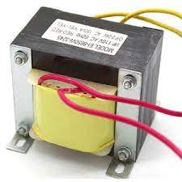
Problem
Most electricians, wind the transformers by themselves in a need.
Both the calculation part and winding process of a transformer is a very time-consuming processes.
Notes:
The main purpose of this machine is to automate every action in transformer winding process.
As a result of this machine, a person who doesn’t capable with prior knowledge of transformer winding process, will be able to wind a transformer by operating this machine.

Slide 5
Project Aim & Objectives
Aim:
Automating every action in the manual transformer winding process and improving the efficiency and effectiveness of the process.
Objectives:
Doesn’t require previous experience in the transformer winding process.
Saving - time.
To minimize the human errors that occur in the transformer winding process.
Notes:
The main purpose of this machine is to automate every action in transformer winding process.
As a result of this machine, a person who doesn’t capable with prior knowledge of transformer winding process, will be able to wind a transformer by operating this machine.

Slide 6
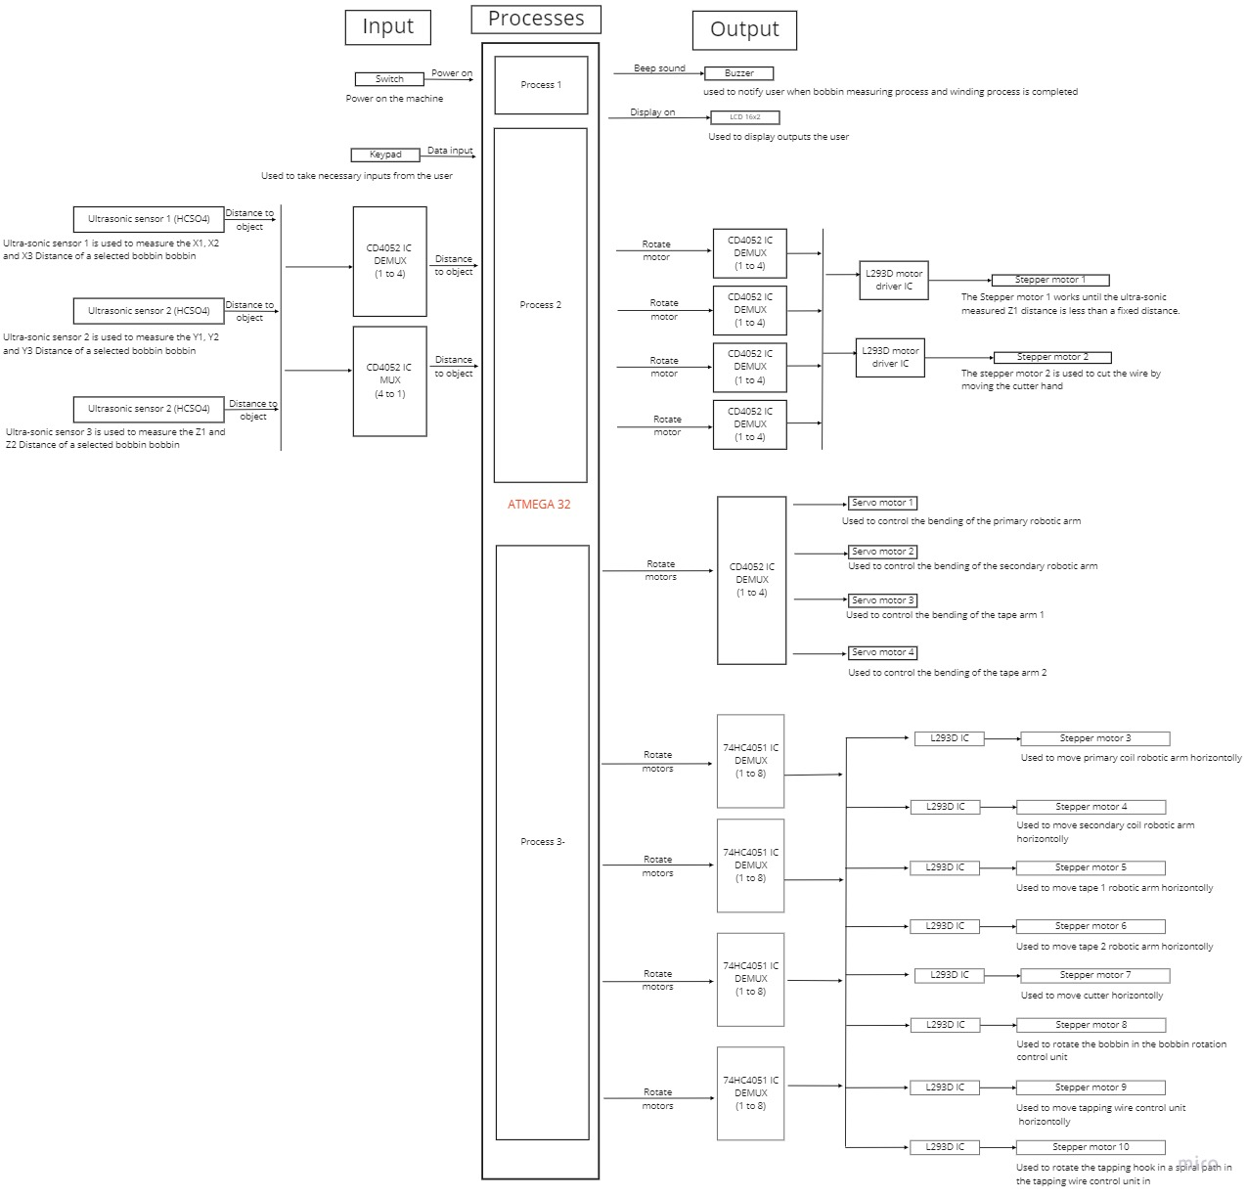
Input – Output Diagram
Notes:
So in this slide you can see the block diagram of the machine. So when designing the machine we have planned to use,
16 by 2 LCD display, a buzzer as main output devices.
And to take inputs from user we use a keypad, and for measurements we planned to use 3 ultra-sonic sensors
For control the moving parts in the machine we mainly use 4 servo motors, 10 stepper motors.

Slide 7
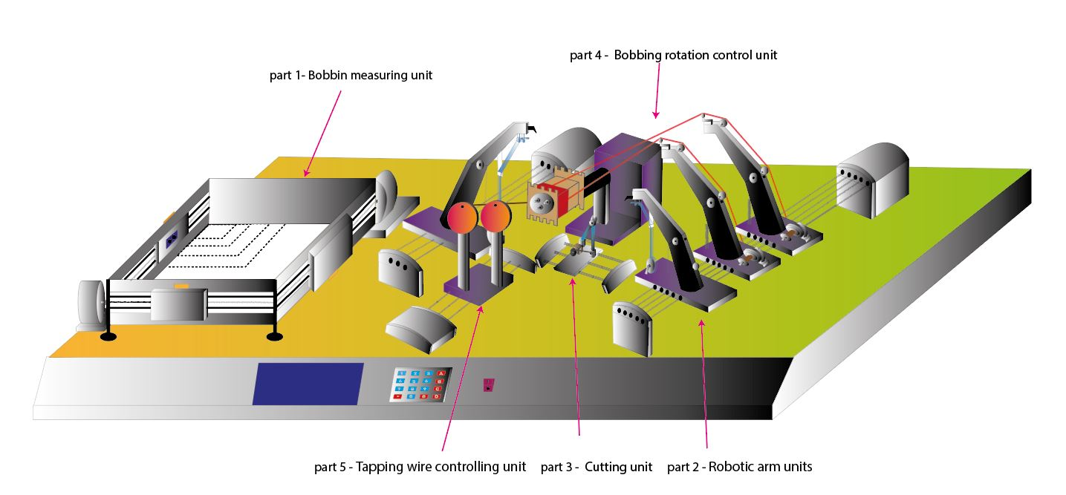
3D –Diagram of the System
Notes:
In this slide you can see the 3d model of the winder. As you can see in the figure, I have devided the machine in to 5 subsections.
So respectively number 1 represent the Bobbin measuring unit.
number 2 represent the Robotic arm unit.
number 3 represent the Cutting unit and number 4 represent the Bobbin rotation controling unit and finally number 5 represent Tapping wire controlling unit.

Slide 8
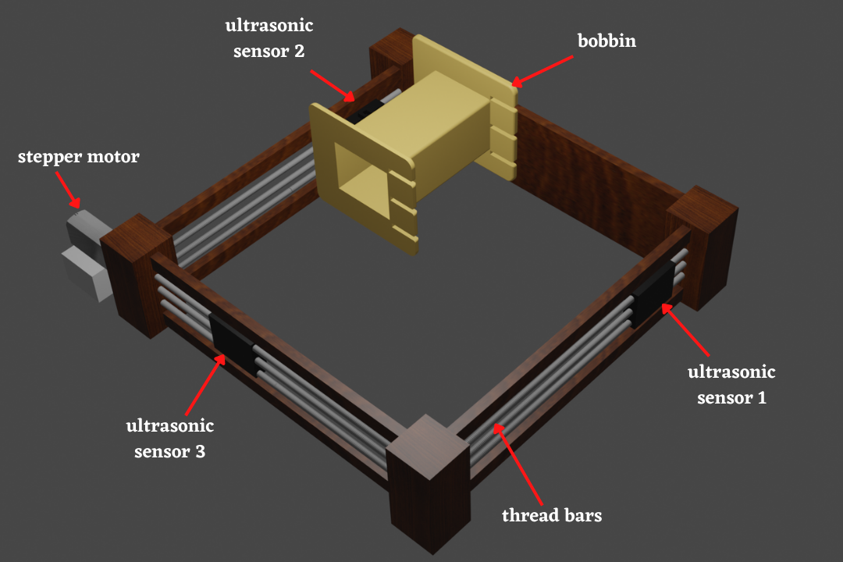
Processes of the machine – Part 1
Notes:
As you can see in this slide, Now I’m going to explain the bobbin measuring unit of the machine.
When designing this unit we have planned to use 3 ultra-sonic sensors and 3 dc motors.
When user switch on the machine, he needs to input the primary voltage and secondary voltage via the keypad. After that user need to input number of tappings to the machine.
After input process is finished, LCD screen will display the relevant core area size for a bobbin. Then user must place the relevant bobbin on top of dotted lines on machine. After placing the bobbin, the measuring unit takes 3 lengths from the bobbin, by using 3 ultrasonic sensors.

Slide 9
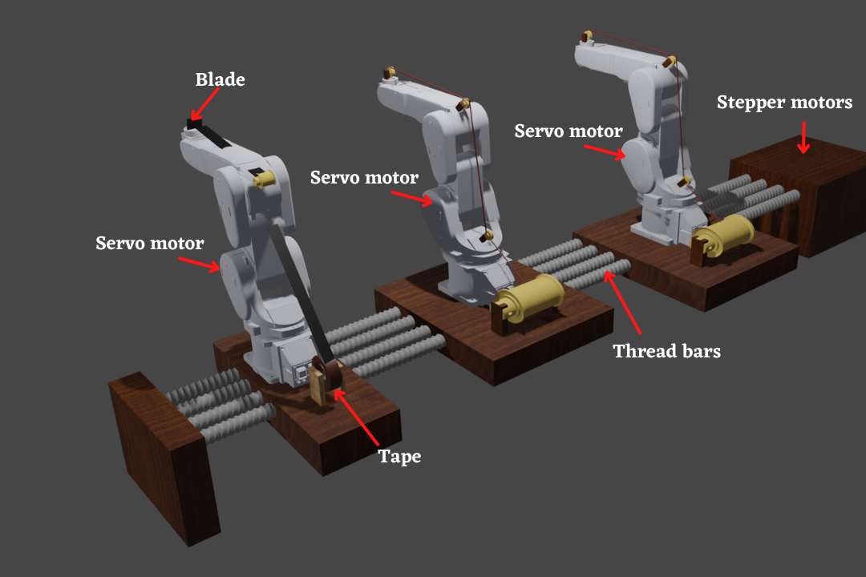
Processes of the machine – Part 2
Notes:
In this slide you can see the second subsection of the winder, the robotic arm unit.
This unit is responsible for guiding the coil to the bobbin when the winding process in on going.
taping arm is also a part of robotic arm unit. In this arms also we have used 3 stepper motors and 3 servo motors.The main purpose of this unit is winding the coil on bobbin covering winded coil on the bobbin with insulation tape.

Slide 10
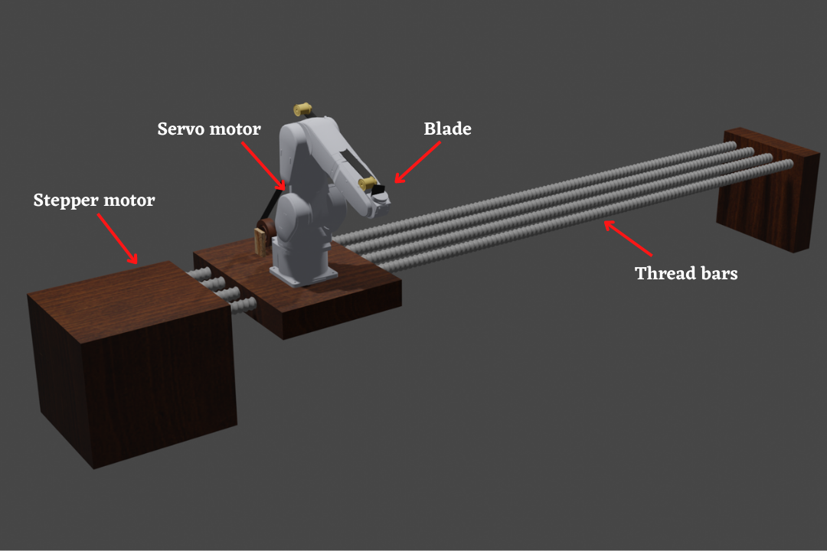
Processes of the machine – Part 2
Notes:
In this slide you can see the taping arm which is a part of robotic arm unit. In this arms also we have used one stepper motor and 1 servo. The main purpose of this unit is covering winded coil on the bobbin with insulation tape.

Slide 11
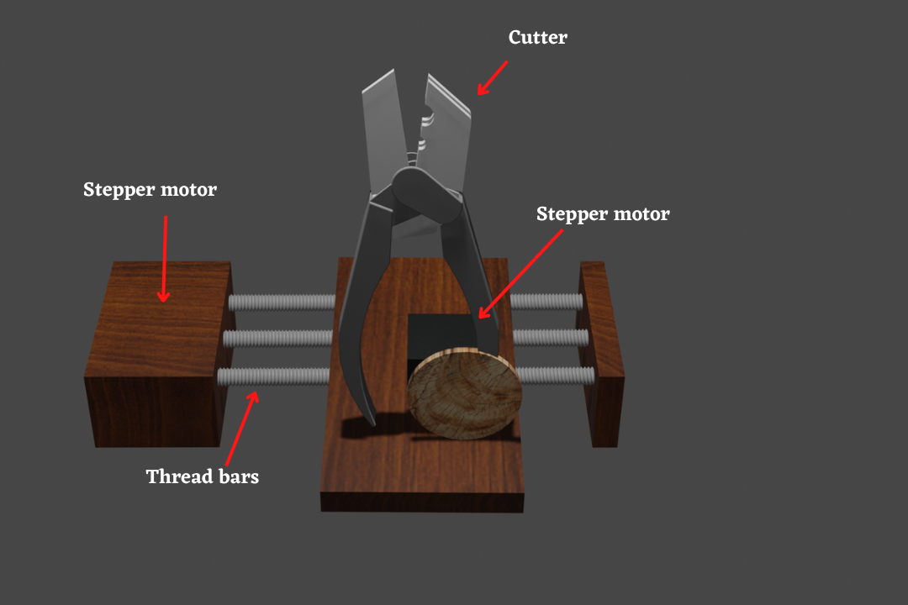
Processes of the machine – Part 3
Notes:
As you can see in this slide, this is the third subsection of the winder. When designing this unit we have used 2 stepper motors. The main purpose of this unit is cutting the primary and secondary coil after the winding process is finished.

Slide 12
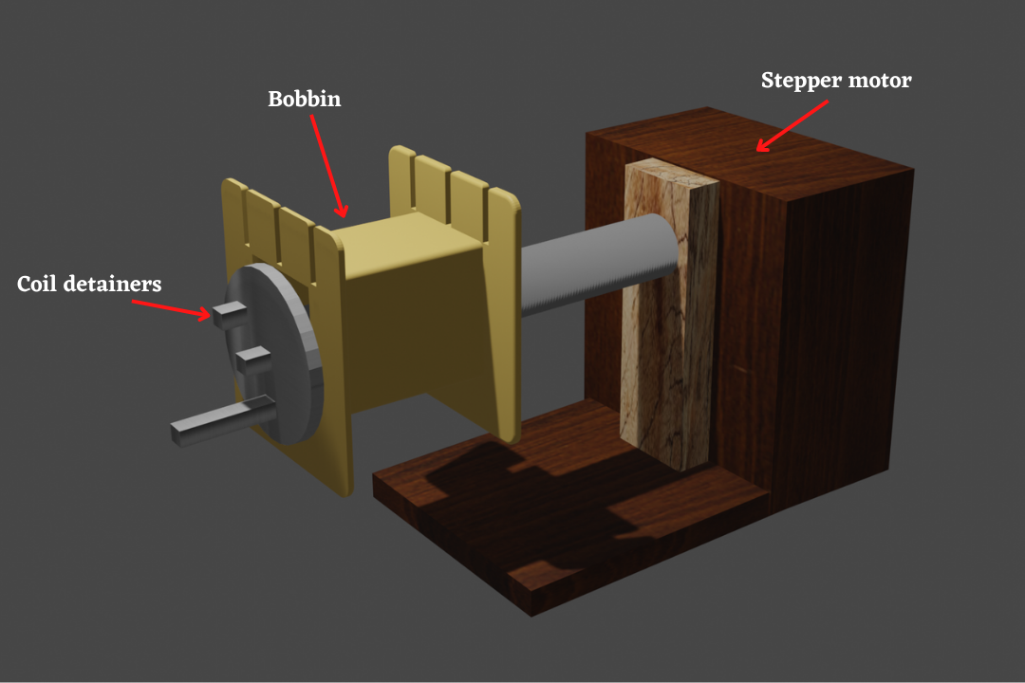
Processes of the machine – Part 4
Notes:
In this slide you can see the forth subsection of the winder, the bobbin rotation control unit. Our team has planned to design this section by using coil detainers, turns counting wheel, a stepper motor.
Coil detainers are used to hold the primary, secondary and the tapping coils.

Slide 13
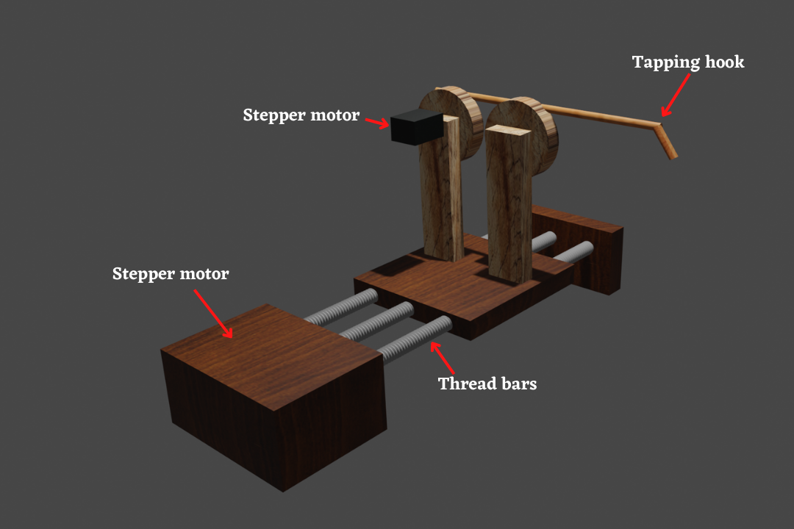
Processes of the machine – Part 5
Notes:
So now I’m going to explain the fifth subsection, the tapping wire control unit.
This unit is specially designed to operate only if user input the tapping voltages to the system. This unit is also contains 2 stepper motors

Slide 14

3D Animation-Bobbin measuring unit
Notes:
In this section we have devided to animation of the winder in to 2 parts as bobbin measuring unit part and winding part.
In this slide you can see the animation of the bobbin measuring unit.

Slide 15
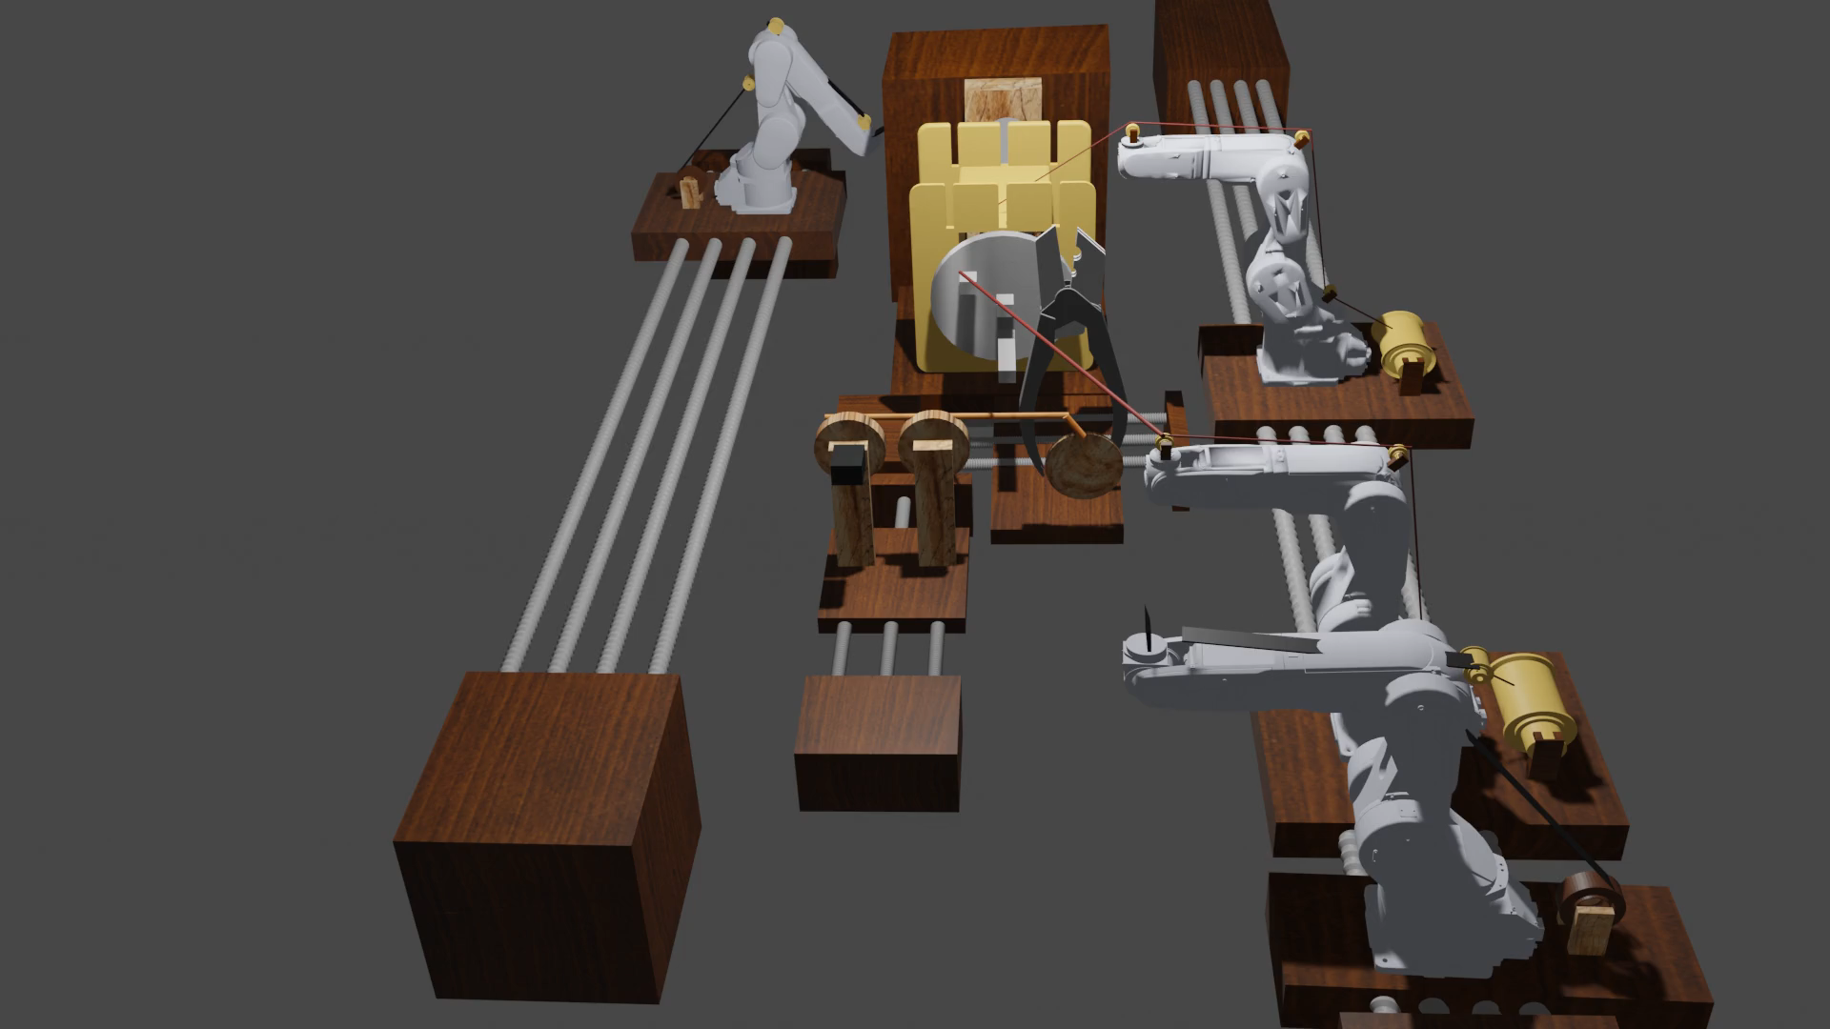
3D Animation-Winding processing unit
Notes:
In this slide you can see the animation of the rest of the parts in the winder.

Slide 16
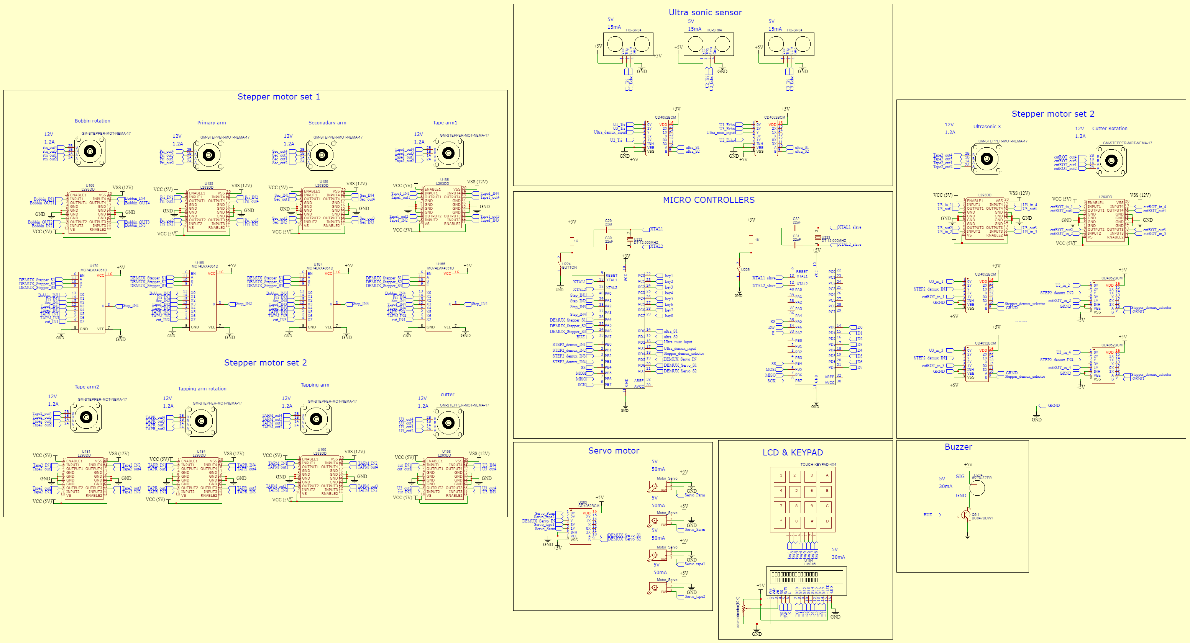
Schematic Diagram of the System
Notes:
So in this slide you can see the complete circuit diagram of the machine. This circuit diagram is designed using easy eda software. In this diagram we have used 2 atmega micro controllers to operate the machine.

Slide 17
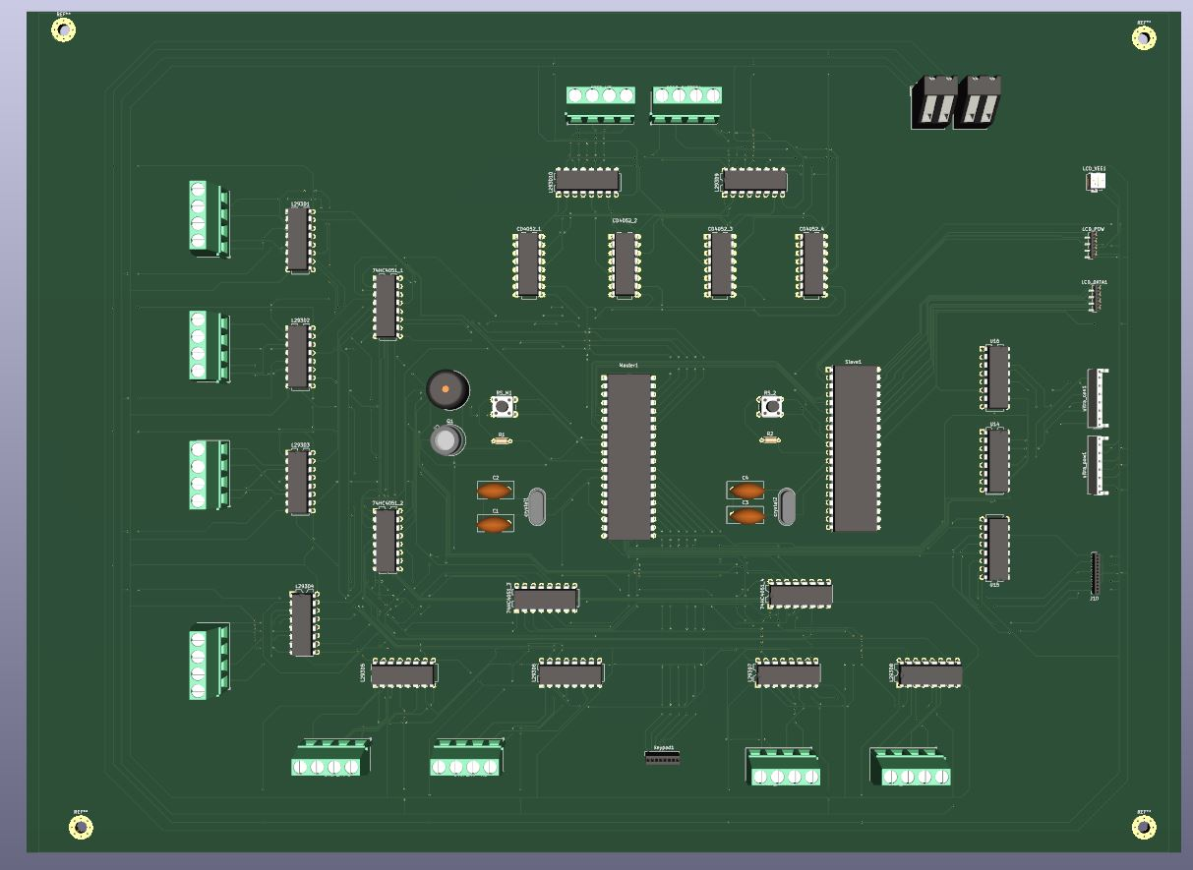
PCB Design
Notes:
In this slide you can see the animation of the rest of the parts in the winder.

Slide 18
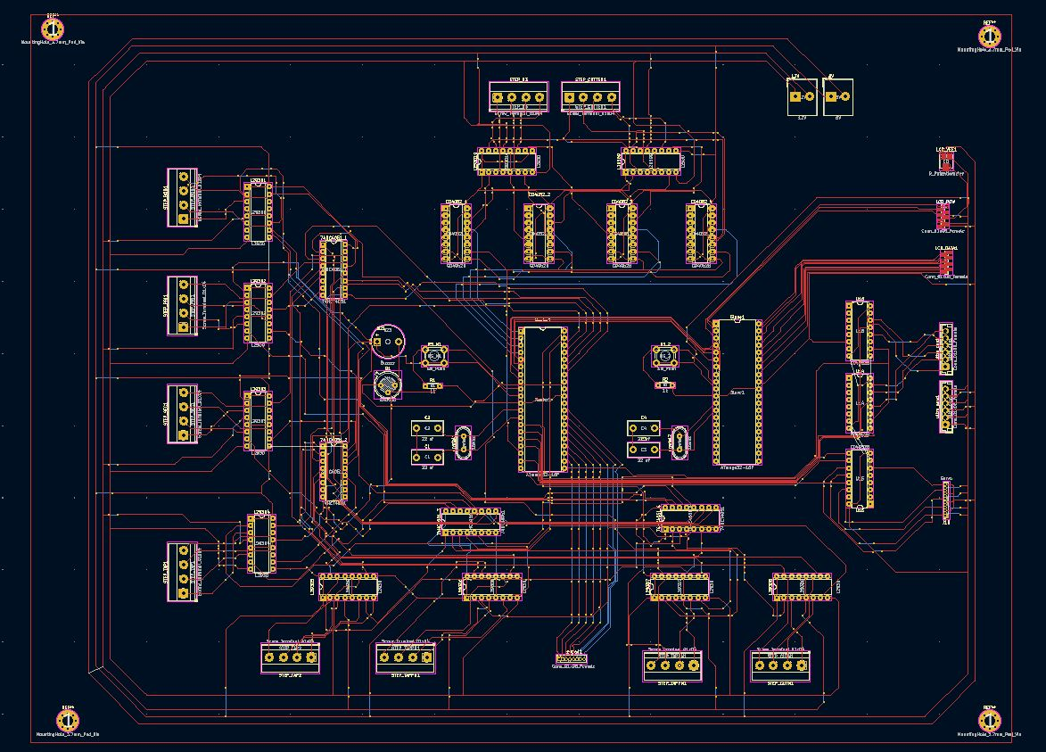
Slik screen
Notes:
In this slide you can see the animation of the rest of the parts in the winder.

Slide 19
Proteus simulation
Notes:
In this slide you can see the animation of the rest of the parts in the winder.

Slide 20





Resources used
Software | Usage
Atmel studio | To programme Atmega32 microcontroller
Proteus software | To simulate the code written for microcontroller
Blender/Adobe illustrator | To develop and animate the 3d model
Ki cad | To design the pcb layout
Easy EDA | To design the schematic design
Notes:
So that was the hardware part of the winder and when developing the software side we are using Atmel studio to program the Atmega 32 microcontroller,
And we have used proteus software to simulate the code written for the microcontroller,
And to develop and animate the 3d model we have used Blender and Adobe illustrator software.

Slide 21
Total cost Estimation
Item/sensor | quantity | Unit price(Rs) | Cost(Rs)
Ultrasonic sensor (HCSR04) | 3 | 200.00 | 600.00
Stepper motor(Nema 17) | 10 | 2700.00 | 27,000.00
Micro Servo motor(5V) | 4 | 600.00 | 3000.00
Keypad | 1 | 160.00 | 160.00
Cutter | 1 | 500.00 | 500.00
16x2 LCD (LM016L) | 1 | 1200.00 | 1200.00
CD4052BCM (1 to 4 demux) | 7 | 400 | 2800.00
74HC4051D (1 to 8 demux) | 4 | 500 | 2000.00
L293D DC motor driver | 10 | 500.00 | 4500.00
Thread bar | 10 | 200.00 | 2000.00
Atmega 32 | 2 | 550.00 | 1100.00
Buzzer | 1 | 100.00 | 100.00
Iron bar | 16 | 200.00 | 3200.00
Wood | 1 | 1500.00 | 1500.00
Total |  |  | 49,660
Notes:
In this slide you can see the estimated cost for the project which is a total of a 51 thousand and 5 hundred and 60 rupees.

Slide 22
Individual Contribution-204129M
Member 1 – 204129M Meegoda S.Y.
Responsibilities -16*2 LCD , keypad, Winding parameters calculation ,PCB design, Saving essential data in EEPROM, power supply design
I was aware of how to use the 16*2 LCD display and keypad. I have used the keypad in the master atmega micro controller, and I have used 16*2 LCD in the slave atmega micro controller. I have established the communication between master and slave micro-controllers by using SPI(Serial peripheral interface). I have used 1024 KB eeprom, to save essential data in array data type which are used for winding parameters calculation part. And also I have designed the PCB design for the full machine and the power supply design by using the ki cad software. I drew the PCB design the 16*2 LCD display and keypad.
Notes:
These are my responsibilities for the project. I was aware of how to get the measurement of a selected bobbin. For that purpose, I used the 3 Ultrasonic sensors and a stepper motor. For the winding purpose, we want to know whether the selected bobbin is suited or not. Two ultrasonic sensors are used to measure the width of the bobbin and measure edge height of the bobbin. And Another sensor was used to measure the length of the bobbin with aid of a stepper motor. Also, I Learned to code atmega32 microcontroller using Atmel studio Software and learned to use Proteus software to simulate the circuit. I was aware of the working mechanism and pins of all the components that I have used. I did the Ultrasonic sensors and stepper motor coding part and simulated the circuit using proteus software. I drew the schematic diagram and PCB design of those components.

Slide 23
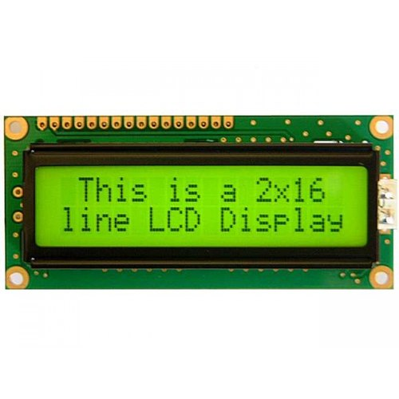
Individual Contribution-204129M
Technique:- 16*2 LCD display
configured the 16*2 LCD display in 8 bit mode.
It is connected to the slave micro-controller.
SPI protocol is used to establish communication between master and slave micro-controllers.
It’s data pins are connected to the port C and it’s command pins are connected to the port A in slave micro – controller.
Notes:
These are my responsibilities for the project. I was aware of how to get the measurement of a selected bobbin. For that purpose, I used the 3 Ultrasonic sensors and a stepper motor. For the winding purpose, we want to know whether the selected bobbin is suited or not. Two ultrasonic sensors are used to measure the width of the bobbin and measure edge height of the bobbin. And Another sensor was used to measure the length of the bobbin with aid of a stepper motor. Also, I Learned to code atmega32 microcontroller using Atmel studio Software and learned to use Proteus software to simulate the circuit. I was aware of the working mechanism and pins of all the components that I have used. I did the Ultrasonic sensors and stepper motor coding part and simulated the circuit using proteus software. I drew the schematic diagram and PCB design of those components.

Slide 24
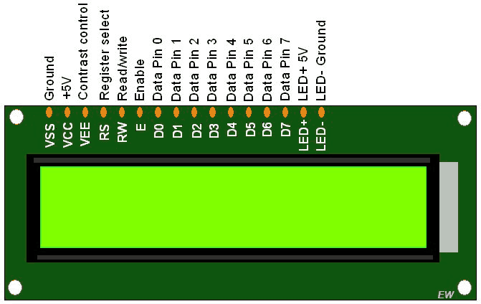
Individual Contribution-204129M
VSS – Connect it to the ground.
VDD – supplies power to the LM016L 16x2 LCD display. You can connect it to the 5V output.
VEE – Used to adjest the brightness level of the display by connecting a potentiometer.
RS – Register selector pin identifies the command or data signal.(command=0 /data=1)
RW–RW identifies the whether to read or write data.(write=0 / read=1)
E(enable) – Enable line needs to send a 1ms pulse after getting pulse, whatever data in there, it will be copying inside the command or data register.
Data pins(D0-D7) – Data pins are used to transfer 8bit size data.
(LED+) and (LED-) – used to power up the backlight of the LCD.
Notes:
These are my responsibilities for the project. I was aware of how to get the measurement of a selected bobbin. For that purpose, I used the 3 Ultrasonic sensors and a stepper motor. For the winding purpose, we want to know whether the selected bobbin is suited or not. Two ultrasonic sensors are used to measure the width of the bobbin and measure edge height of the bobbin. And Another sensor was used to measure the length of the bobbin with aid of a stepper motor. Also, I Learned to code atmega32 microcontroller using Atmel studio Software and learned to use Proteus software to simulate the circuit. I was aware of the working mechanism and pins of all the components that I have used. I did the Ultrasonic sensors and stepper motor coding part and simulated the circuit using proteus software. I drew the schematic diagram and PCB design of those components.

Slide 25
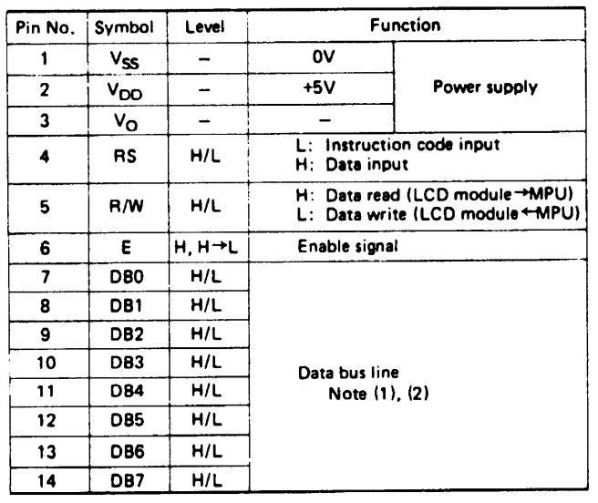
Individual Contribution-204129M
Technical Specifications
Notes:
These are my responsibilities for the project. I was aware of how to get the measurement of a selected bobbin. For that purpose, I used the 3 Ultrasonic sensors and a stepper motor. For the winding purpose, we want to know whether the selected bobbin is suited or not. Two ultrasonic sensors are used to measure the width of the bobbin and measure edge height of the bobbin. And Another sensor was used to measure the length of the bobbin with aid of a stepper motor. Also, I Learned to code atmega32 microcontroller using Atmel studio Software and learned to use Proteus software to simulate the circuit. I was aware of the working mechanism and pins of all the components that I have used. I did the Ultrasonic sensors and stepper motor coding part and simulated the circuit using proteus software. I drew the schematic diagram and PCB design of those components.

Slide 26
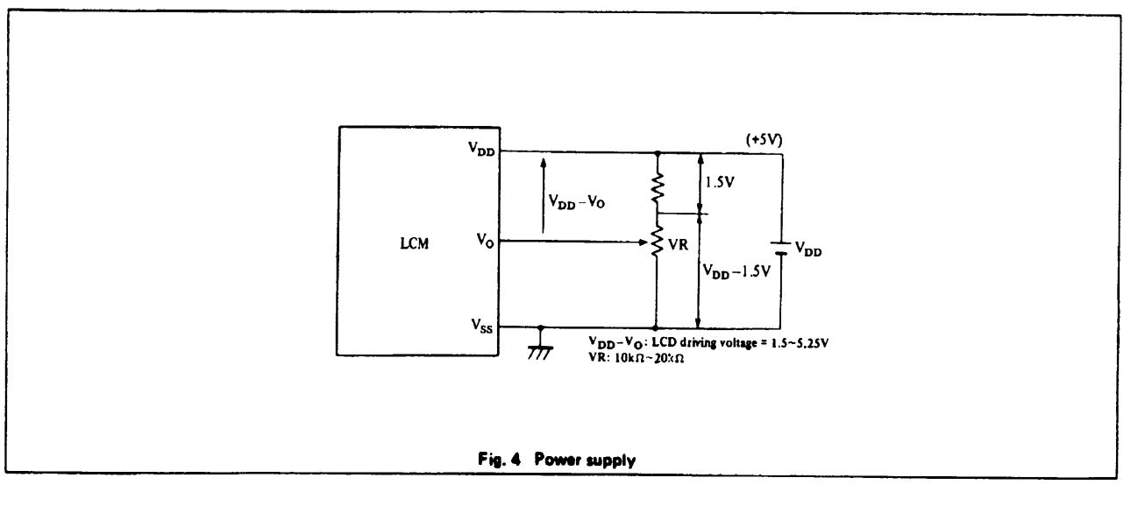
Individual Contribution-204129M
The internal circuit of the LCD display
Data sheet-
https://www.farnell.com/datasheets/305035.pdf
Notes:
These are my responsibilities for the project. I was aware of how to get the measurement of a selected bobbin. For that purpose, I used the 3 Ultrasonic sensors and a stepper motor. For the winding purpose, we want to know whether the selected bobbin is suited or not. Two ultrasonic sensors are used to measure the width of the bobbin and measure edge height of the bobbin. And Another sensor was used to measure the length of the bobbin with aid of a stepper motor. Also, I Learned to code atmega32 microcontroller using Atmel studio Software and learned to use Proteus software to simulate the circuit. I was aware of the working mechanism and pins of all the components that I have used. I did the Ultrasonic sensors and stepper motor coding part and simulated the circuit using proteus software. I drew the schematic diagram and PCB design of those components.

Slide 27
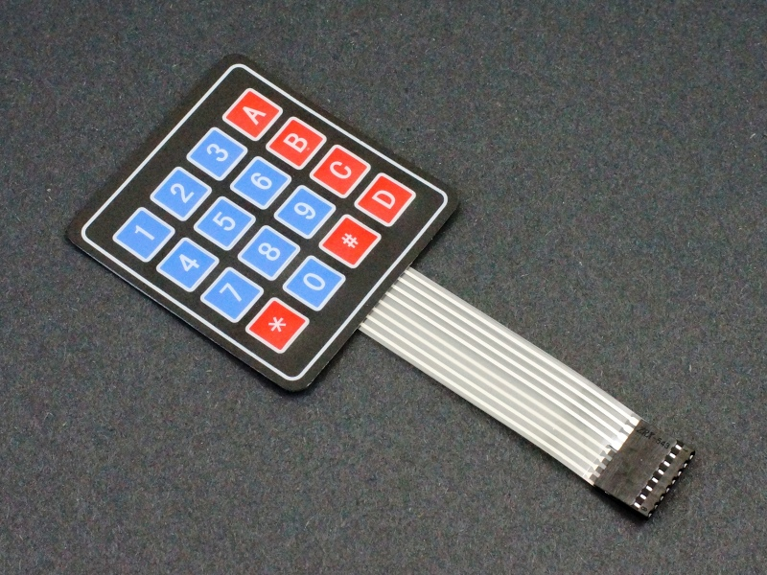
Individual Contribution-204129M
Technique – 4x4 Keypad
connected the keypad to the port C in master atmega micro-controller.
There are 16 push buttons and 8 connection pins.
To pass the relevant pressed key value to the LCD display SPI protocol is used.
0-9 digits are ised to take integer inputs from the user and ‘#’ key is set as enter key.
Notes:
These are my responsibilities for the project. I was aware of how to get the measurement of a selected bobbin. For that purpose, I used the 3 Ultrasonic sensors and a stepper motor. For the winding purpose, we want to know whether the selected bobbin is suited or not. Two ultrasonic sensors are used to measure the width of the bobbin and measure edge height of the bobbin. And Another sensor was used to measure the length of the bobbin with aid of a stepper motor. Also, I Learned to code atmega32 microcontroller using Atmel studio Software and learned to use Proteus software to simulate the circuit. I was aware of the working mechanism and pins of all the components that I have used. I did the Ultrasonic sensors and stepper motor coding part and simulated the circuit using proteus software. I drew the schematic diagram and PCB design of those components.

Slide 28
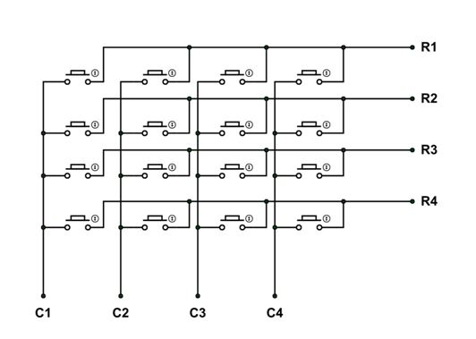
Individual Contribution-204129M
The internal circuit of the keypad
Data sheet-
http://www.electronicoscaldas.com/datasheet/Teclado-membrana-matricial-4x4.pdf
Notes:
These are my responsibilities for the project. I was aware of how to get the measurement of a selected bobbin. For that purpose, I used the 3 Ultrasonic sensors and a stepper motor. For the winding purpose, we want to know whether the selected bobbin is suited or not. Two ultrasonic sensors are used to measure the width of the bobbin and measure edge height of the bobbin. And Another sensor was used to measure the length of the bobbin with aid of a stepper motor. Also, I Learned to code atmega32 microcontroller using Atmel studio Software and learned to use Proteus software to simulate the circuit. I was aware of the working mechanism and pins of all the components that I have used. I did the Ultrasonic sensors and stepper motor coding part and simulated the circuit using proteus software. I drew the schematic diagram and PCB design of those components.

Slide 29
Individual Contribution-204129M
Technique :- Saving essential data in the EEPROM
To determine parameters for the winding process, some essential data are needed to save in the EEPROM of the atmega micro controller.
Array data type is used to save these data in the EEPROM.
Data needed to save in the EEPROM are,
Standard wire gauge.
Diameters of the coils.
Maximum amperages through the coils.
Turns per square centimetres for relevant coil.
EI-Lamination model numbers.
Core area(cm²).
Notes:
These are my responsibilities for the project. I was aware of how to get the measurement of a selected bobbin. For that purpose, I used the 3 Ultrasonic sensors and a stepper motor. For the winding purpose, we want to know whether the selected bobbin is suited or not. Two ultrasonic sensors are used to measure the width of the bobbin and measure edge height of the bobbin. And Another sensor was used to measure the length of the bobbin with aid of a stepper motor. Also, I Learned to code atmega32 microcontroller using Atmel studio Software and learned to use Proteus software to simulate the circuit. I was aware of the working mechanism and pins of all the components that I have used. I did the Ultrasonic sensors and stepper motor coding part and simulated the circuit using proteus software. I drew the schematic diagram and PCB design of those components.

Slide 30
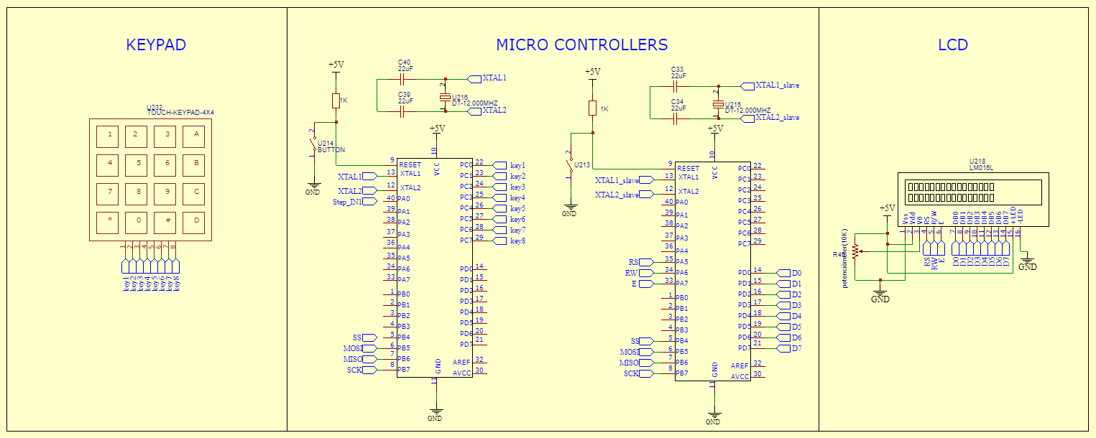
Individual Contribution-204129M
Schematic diagram
Notes:
These are my responsibilities for the project. I was aware of how to get the measurement of a selected bobbin. For that purpose, I used the 3 Ultrasonic sensors and a stepper motor. For the winding purpose, we want to know whether the selected bobbin is suited or not. Two ultrasonic sensors are used to measure the width of the bobbin and measure edge height of the bobbin. And Another sensor was used to measure the length of the bobbin with aid of a stepper motor. Also, I Learned to code atmega32 microcontroller using Atmel studio Software and learned to use Proteus software to simulate the circuit. I was aware of the working mechanism and pins of all the components that I have used. I did the Ultrasonic sensors and stepper motor coding part and simulated the circuit using proteus software. I drew the schematic diagram and PCB design of those components.

Slide 31
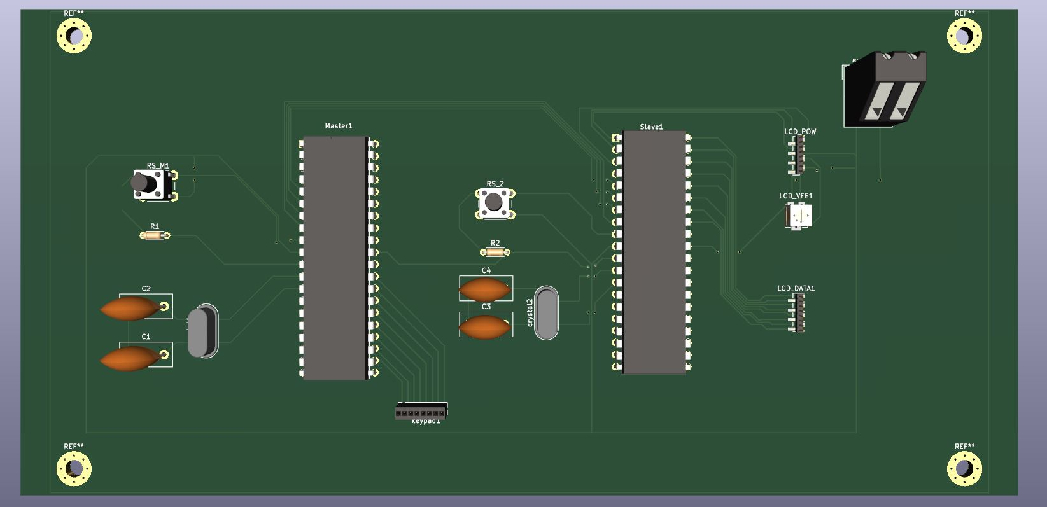
Individual Contribution-204129M
PCB design
Notes:
These are my responsibilities for the project. I was aware of how to get the measurement of a selected bobbin. For that purpose, I used the 3 Ultrasonic sensors and a stepper motor. For the winding purpose, we want to know whether the selected bobbin is suited or not. Two ultrasonic sensors are used to measure the width of the bobbin and measure edge height of the bobbin. And Another sensor was used to measure the length of the bobbin with aid of a stepper motor. Also, I Learned to code atmega32 microcontroller using Atmel studio Software and learned to use Proteus software to simulate the circuit. I was aware of the working mechanism and pins of all the components that I have used. I did the Ultrasonic sensors and stepper motor coding part and simulated the circuit using proteus software. I drew the schematic diagram and PCB design of those components.

Slide 32
Individual Contribution-204129M
Full PCB design
Notes:
Now you can see the coding part of the eeprom. So form now on heshan will continue the rest of the part in presentation.thank you.

Slide 33
Individual Contribution-204129M
Power supply design
Notes:
Now you can see the coding part of the eeprom. So form now on heshan will continue the rest of the part in presentation.thank you.

Slide 34
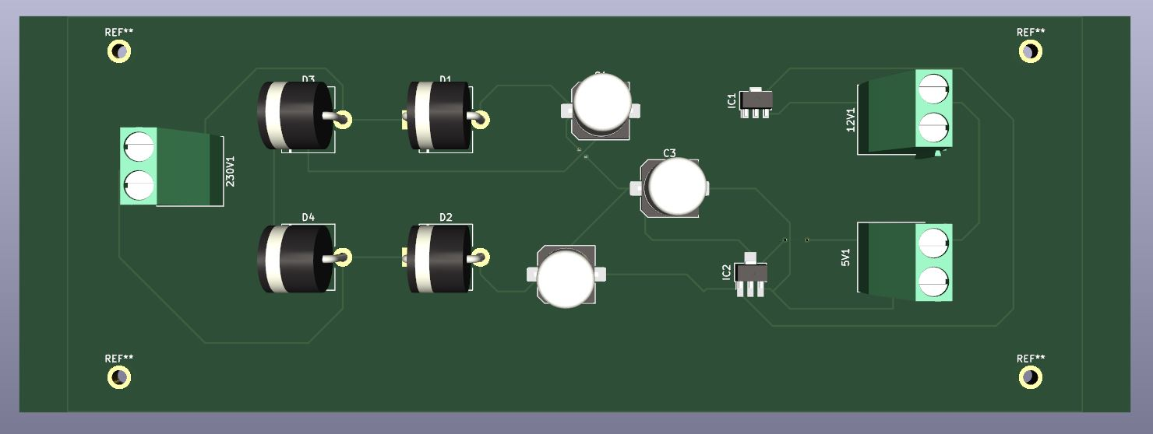
Individual Contribution-204129M
PCB design
Notes:
Now you can see the coding part of the eeprom. So form now on heshan will continue the rest of the part in presentation.thank you.

Slide 35
Individual Contribution-204129M
Proteus Simulation
Notes:
These are my responsibilities for the project. I was aware of how to get the measurement of a selected bobbin. For that purpose, I used the 3 Ultrasonic sensors and a stepper motor. For the winding purpose, we want to know whether the selected bobbin is suited or not. Two ultrasonic sensors are used to measure the width of the bobbin and measure edge height of the bobbin. And Another sensor was used to measure the length of the bobbin with aid of a stepper motor. Also, I Learned to code atmega32 microcontroller using Atmel studio Software and learned to use Proteus software to simulate the circuit. I was aware of the working mechanism and pins of all the components that I have used. I did the Ultrasonic sensors and stepper motor coding part and simulated the circuit using proteus software. I drew the schematic diagram and PCB design of those components.

Slide 36
Individual Contribution-204197R
Member 2 – 204197R Senevirathne Y.M.N.N.
Responsibilities -Bobbin measuring unit
I was aware of how to get the measurement of a selected bobbin. For that purpose, I used the 3 HCSRO4-Ultrasonic sensors and a NEMA 17 bipolar stepper motor. Also, 2 CD4052 IC are used to connect those sensors with microcontrollers and 4 CD4052 IC and 2 L293D IC are used to connect that stepper motor with ATMEGA32. For the winding purpose, we want to know whether the selected bobbin is suited or not. Two ultrasonic sensors are used to measure the width of the bobbin and measure edge height of the bobbin. And Another sensor was used to measure the length of the bobbin with aid of a stepper motor.
Notes:
These are my responsibilities for the project. I was aware of how to get the measurement of a selected bobbin. For that purpose, I used the 3 Ultrasonic sensors and a stepper motor. For the winding purpose, we want to know whether the selected bobbin is suited or not. Two ultrasonic sensors are used to measure the width of the bobbin and measure edge height of the bobbin. And Another sensor was used to measure the length of the bobbin with aid of a stepper motor. Also, I Learned to code atmega32 microcontroller using Atmel studio Software and learned to use Proteus software to simulate the circuit. I was aware of the working mechanism and pins of all the components that I have used. I did the Ultrasonic sensors and stepper motor coding part and simulated the circuit using proteus software. I drew the schematic diagram and PCB design of those components.

Slide 37
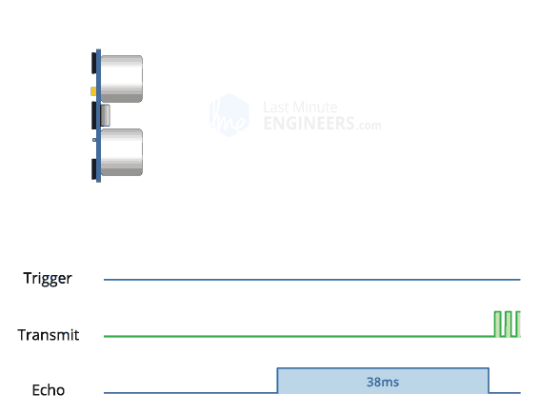
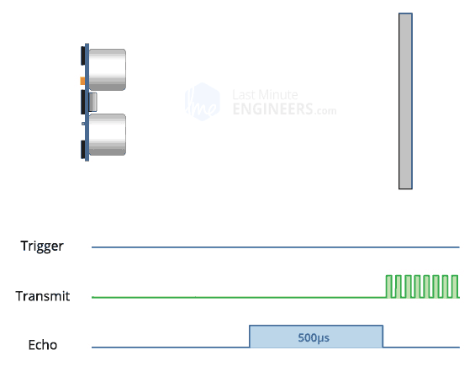
Individual Contribution-204197R
Technique:- HC-SRO4 ultrasonic sensor
trigger pin is set HIGH for 10µs.
the sensor transmits an ultrasonic burst of eight pulses at 40 kHz.
Meanwhile the echo pin goes HIGH to initiate the echo-back signal.
If those pulses are reflected, the echo pin goes low as soon as the signal is received.
The width of the received pulse is used to calculate the distance from the reflected object.
Notes:
These are my responsibilities for the project. I was aware of how to get the measurement of a selected bobbin. For that purpose, I used the 3 Ultrasonic sensors and a stepper motor. For the winding purpose, we want to know whether the selected bobbin is suited or not. Two ultrasonic sensors are used to measure the width of the bobbin and measure edge height of the bobbin. And Another sensor was used to measure the length of the bobbin with aid of a stepper motor. Also, I Learned to code atmega32 microcontroller using Atmel studio Software and learned to use Proteus software to simulate the circuit. I was aware of the working mechanism and pins of all the components that I have used. I did the Ultrasonic sensors and stepper motor coding part and simulated the circuit using proteus software. I drew the schematic diagram and PCB design of those components.

Slide 38
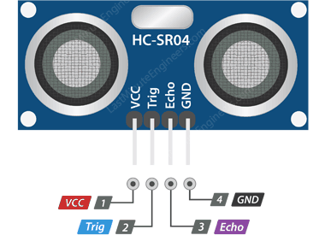
Individual Contribution-204197R
HC-SR04 ultrasonic sensor Pinout
VCC -supplies power to the HC-SR04 ultrasonic sensor. You can connect it to the 5V output.
Trig(Trigger)-pin is used to trigger ultrasonic sound pulses. By setting this pin to HIGH for 10µs, the sensor initiates an ultrasonic burst.
Echo - pin goes high when the ultrasonic burst is transmitted and remains high until the sensor receives an echo, after which it goes low.
GND(Ground) - Connect it to the ground.
Notes:
These are my responsibilities for the project. I was aware of how to get the measurement of a selected bobbin. For that purpose, I used the 3 Ultrasonic sensors and a stepper motor. For the winding purpose, we want to know whether the selected bobbin is suited or not. Two ultrasonic sensors are used to measure the width of the bobbin and measure edge height of the bobbin. And Another sensor was used to measure the length of the bobbin with aid of a stepper motor. Also, I Learned to code atmega32 microcontroller using Atmel studio Software and learned to use Proteus software to simulate the circuit. I was aware of the working mechanism and pins of all the components that I have used. I did the Ultrasonic sensors and stepper motor coding part and simulated the circuit using proteus software. I drew the schematic diagram and PCB design of those components.

Slide 39
Individual Contribution-204197R
Technical Specifications – Ultrasonic sensor
Operating Voltage | DC 5V
Operating Current | 15mA
Operating Frequency | 40KHz
Max Range | 4m
Min Range | 2cm
Ranging Accuracy | 3mm
Measuring Angle | 15 degree
Trigger Input Signal | 10µS TTL pulse
Dimension | 45 x 20 x 15mm
Notes:
These are my responsibilities for the project. I was aware of how to get the measurement of a selected bobbin. For that purpose, I used the 3 Ultrasonic sensors and a stepper motor. For the winding purpose, we want to know whether the selected bobbin is suited or not. Two ultrasonic sensors are used to measure the width of the bobbin and measure edge height of the bobbin. And Another sensor was used to measure the length of the bobbin with aid of a stepper motor. Also, I Learned to code atmega32 microcontroller using Atmel studio Software and learned to use Proteus software to simulate the circuit. I was aware of the working mechanism and pins of all the components that I have used. I did the Ultrasonic sensors and stepper motor coding part and simulated the circuit using proteus software. I drew the schematic diagram and PCB design of those components.

Slide 40
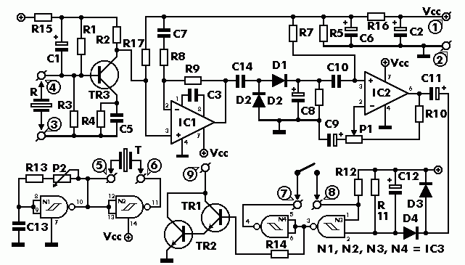
Individual Contribution-204197R
The internal circuit of the ultrasonic sensor
Data sheet-https://components101.com/sites/default/files/component_datasheet/HCSR04%20Datasheet.pdf
Notes:
These are my responsibilities for the project. I was aware of how to get the measurement of a selected bobbin. For that purpose, I used the 3 Ultrasonic sensors and a stepper motor. For the winding purpose, we want to know whether the selected bobbin is suited or not. Two ultrasonic sensors are used to measure the width of the bobbin and measure edge height of the bobbin. And Another sensor was used to measure the length of the bobbin with aid of a stepper motor. Also, I Learned to code atmega32 microcontroller using Atmel studio Software and learned to use Proteus software to simulate the circuit. I was aware of the working mechanism and pins of all the components that I have used. I did the Ultrasonic sensors and stepper motor coding part and simulated the circuit using proteus software. I drew the schematic diagram and PCB design of those components.

Slide 41
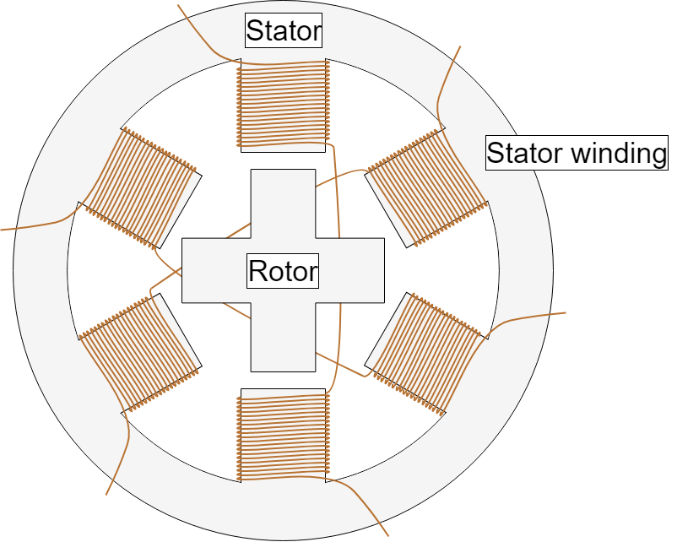
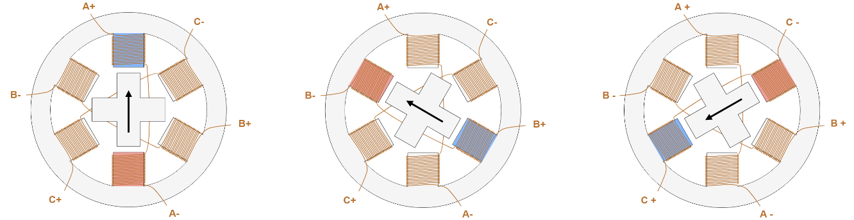
Individual Contribaution-204197R
Technique – NEMA 17 bipolar stepper motor
Motor has a stationary part (the stator) and a moving part (the rotor).
On the stator, there are teeth on which coils are wired.
The rotor is either a permanent magnet or a variable reluctance iron core.
By energizing one or more of the stator phases, a magnetic field is generated by the current flowing in the coil and the rotor aligns with this field.
By supplying different phases in sequence, the rotor can be rotated by a specific amount to reach the desired final position.
Notes:
These are my responsibilities for the project. I was aware of how to get the measurement of a selected bobbin. For that purpose, I used the 3 Ultrasonic sensors and a stepper motor. For the winding purpose, we want to know whether the selected bobbin is suited or not. Two ultrasonic sensors are used to measure the width of the bobbin and measure edge height of the bobbin. And Another sensor was used to measure the length of the bobbin with aid of a stepper motor. Also, I Learned to code atmega32 microcontroller using Atmel studio Software and learned to use Proteus software to simulate the circuit. I was aware of the working mechanism and pins of all the components that I have used. I did the Ultrasonic sensors and stepper motor coding part and simulated the circuit using proteus software. I drew the schematic diagram and PCB design of those components.

Slide 42
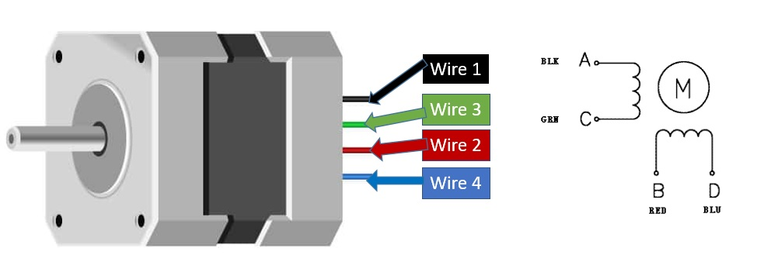
Individual Contribution-204197R
NEMA 17 bipolar stepper motor Pinout
Notes:
These are my responsibilities for the project. I was aware of how to get the measurement of a selected bobbin. For that purpose, I used the 3 Ultrasonic sensors and a stepper motor. For the winding purpose, we want to know whether the selected bobbin is suited or not. Two ultrasonic sensors are used to measure the width of the bobbin and measure edge height of the bobbin. And Another sensor was used to measure the length of the bobbin with aid of a stepper motor. Also, I Learned to code atmega32 microcontroller using Atmel studio Software and learned to use Proteus software to simulate the circuit. I was aware of the working mechanism and pins of all the components that I have used. I did the Ultrasonic sensors and stepper motor coding part and simulated the circuit using proteus software. I drew the schematic diagram and PCB design of those components.

Slide 43
Individual Contribution-204197R
Specifications -NEMA 17 bipolar stepper motor
Voltage | 4V
Rated Current/phase | 0.95A
Step Angle | 1.8°
No. of Phases | 4
Phase Resistance | 3.3ohm
Inductance | 4mH
Length | 33mm
Rotor Inertia | 35g-cm²
Shaft Diameter | Φ5mm
Shaft Length | 22mm
Frame size | 42 x 42mm
Unipolar Holding Torque | 2.59kg-cm(36oz-in)
Notes:
These are my responsibilities for the project. I was aware of how to get the measurement of a selected bobbin. For that purpose, I used the 3 Ultrasonic sensors and a stepper motor. For the winding purpose, we want to know whether the selected bobbin is suited or not. Two ultrasonic sensors are used to measure the width of the bobbin and measure edge height of the bobbin. And Another sensor was used to measure the length of the bobbin with aid of a stepper motor. Also, I Learned to code atmega32 microcontroller using Atmel studio Software and learned to use Proteus software to simulate the circuit. I was aware of the working mechanism and pins of all the components that I have used. I did the Ultrasonic sensors and stepper motor coding part and simulated the circuit using proteus software. I drew the schematic diagram and PCB design of those components.

Slide 44
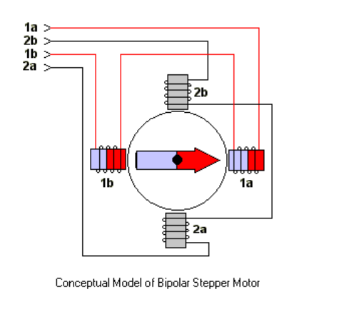
Individual Contribution-204197R
The internal circuit of the stepper motor
Data sheet-https://datasheetspdf.com/pdf-file/1260602/Schneider/NEMA17/1
Notes:
These are my responsibilities for the project. I was aware of how to get the measurement of a selected bobbin. For that purpose, I used the 3 Ultrasonic sensors and a stepper motor. For the winding purpose, we want to know whether the selected bobbin is suited or not. Two ultrasonic sensors are used to measure the width of the bobbin and measure edge height of the bobbin. And Another sensor was used to measure the length of the bobbin with aid of a stepper motor. Also, I Learned to code atmega32 microcontroller using Atmel studio Software and learned to use Proteus software to simulate the circuit. I was aware of the working mechanism and pins of all the components that I have used. I did the Ultrasonic sensors and stepper motor coding part and simulated the circuit using proteus software. I drew the schematic diagram and PCB design of those components.

Slide 45
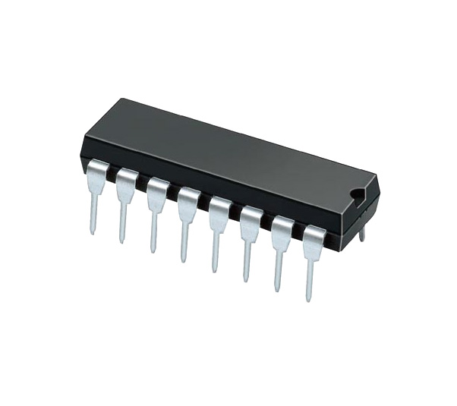
Individual Contribution-204197R
Technique:- CD4052 MUX/DEMUX IC
Can be used as a 4:1 Multiplexer.
Take inputs from 4-channel and convert them to single channel output based on the channel select pins.
Input channels are X0Y0, X1Y1, X2Y2 and X3 and Y3 and the single output channel is X, Y.
The output on the single channel is decided based on the channel select pins A and B.
Also, can be used as a 1:4 Demultiplexer.
Input pins will be X and Y.
The output pins can either be X0, Y0 or X1, Y1 or X2, Y2 or X3, Y3 based on the value set on A and B pins.
The state of the select pins and channel selection is shown in the table.
A | B | Channel Selected
0 | 0 | Channel 0
1 | 0 | Channel 1
0 | 1 | Channel 2
1 | 1 | Channel 3
Notes:
These are my responsibilities for the project. I was aware of how to get the measurement of a selected bobbin. For that purpose, I used the 3 Ultrasonic sensors and a stepper motor. For the winding purpose, we want to know whether the selected bobbin is suited or not. Two ultrasonic sensors are used to measure the width of the bobbin and measure edge height of the bobbin. And Another sensor was used to measure the length of the bobbin with aid of a stepper motor. Also, I Learned to code atmega32 microcontroller using Atmel studio Software and learned to use Proteus software to simulate the circuit. I was aware of the working mechanism and pins of all the components that I have used. I did the Ultrasonic sensors and stepper motor coding part and simulated the circuit using proteus software. I drew the schematic diagram and PCB design of those components.

Slide 46
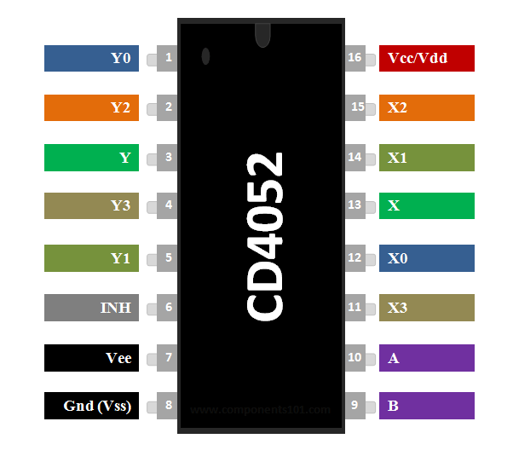
Individual Contribution-204197R
CD4052 MUX/DEMUX IC Pinout
Pin Number | Pin Name | Description
16 | Vdd | Positive power input, maximum 20V
7 | Vee | Negative power rail, normally connected to ground
8 | Vss (Ground) | Connected to ground of the circuit
6 | INH | Enable pin – Must be pulled to ground for normal operation
9,10 | A,B | Channel Select pins
1,12 | Y0,X0 | Channel 0 Input / Output
5,14 | Y1,X1 | Channel 1 Input / Output
2,15 | Y2,X2 | Channel 2 Input / Output
4,11 | Y3,X3 | Channel 3 Input / Output
3,13 | Y,X | Common Output / Input
Notes:
These are my responsibilities for the project. I was aware of how to get the measurement of a selected bobbin. For that purpose, I used the 3 Ultrasonic sensors and a stepper motor. For the winding purpose, we want to know whether the selected bobbin is suited or not. Two ultrasonic sensors are used to measure the width of the bobbin and measure edge height of the bobbin. And Another sensor was used to measure the length of the bobbin with aid of a stepper motor. Also, I Learned to code atmega32 microcontroller using Atmel studio Software and learned to use Proteus software to simulate the circuit. I was aware of the working mechanism and pins of all the components that I have used. I did the Ultrasonic sensors and stepper motor coding part and simulated the circuit using proteus software. I drew the schematic diagram and PCB design of those components.

Slide 47
Individual Contribution-204197R
Specifications - CD4052 MUX/DEMUX IC
Dual 4 Channel Analog Multiplexer or Demultiplexer
Supply Voltage Range: 3 to 15V
Input Current: ±10mA
Power Dissipation: 750mW
Low-level Input Voltage Max.: 1.5V
High-level Input Voltage Min.: 3.5V
On State Resistance Max.: 2500Ω
Propagation Delay Time Max.: 305ns
Min Operating Temperature: -55°C
Max Operating Temperature: 125°C
Notes:
These are my responsibilities for the project. I was aware of how to get the measurement of a selected bobbin. For that purpose, I used the 3 Ultrasonic sensors and a stepper motor. For the winding purpose, we want to know whether the selected bobbin is suited or not. Two ultrasonic sensors are used to measure the width of the bobbin and measure edge height of the bobbin. And Another sensor was used to measure the length of the bobbin with aid of a stepper motor. Also, I Learned to code atmega32 microcontroller using Atmel studio Software and learned to use Proteus software to simulate the circuit. I was aware of the working mechanism and pins of all the components that I have used. I did the Ultrasonic sensors and stepper motor coding part and simulated the circuit using proteus software. I drew the schematic diagram and PCB design of those components.

Slide 48
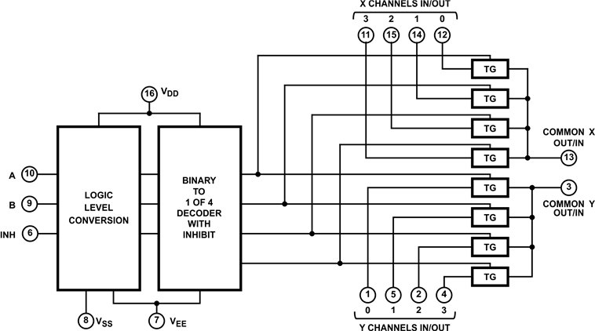
Individual Contribution-204197R
The internal circuit of the CD4052 IC
Data sheet-https://components101.com/sites/default/files/component_datasheet/CD4052-Datasheet.pdf
Notes:
These are my responsibilities for the project. I was aware of how to get the measurement of a selected bobbin. For that purpose, I used the 3 Ultrasonic sensors and a stepper motor. For the winding purpose, we want to know whether the selected bobbin is suited or not. Two ultrasonic sensors are used to measure the width of the bobbin and measure edge height of the bobbin. And Another sensor was used to measure the length of the bobbin with aid of a stepper motor. Also, I Learned to code atmega32 microcontroller using Atmel studio Software and learned to use Proteus software to simulate the circuit. I was aware of the working mechanism and pins of all the components that I have used. I did the Ultrasonic sensors and stepper motor coding part and simulated the circuit using proteus software. I drew the schematic diagram and PCB design of those components.

Slide 49
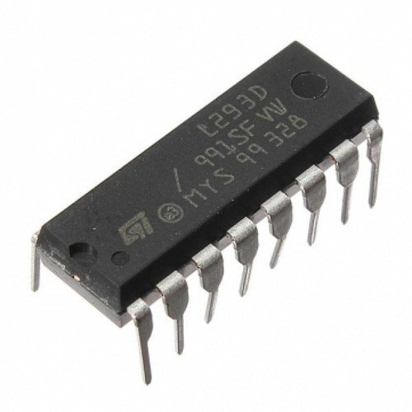
Individual Contribution-204197R
Technique:- L293D motor driver IC
low voltage operating device.
provides the continuous bidirectional Direct Current to the Motor.
has an internal H-bridge installed for a single stepper motor.
H-Bridge is an electrical circuit that enables the load in a bidirectional way.
It could control any motor speed and direction with a voltage range of 4.5 – 36 Volts
Notes:
These are my responsibilities for the project. I was aware of how to get the measurement of a selected bobbin. For that purpose, I used the 3 Ultrasonic sensors and a stepper motor. For the winding purpose, we want to know whether the selected bobbin is suited or not. Two ultrasonic sensors are used to measure the width of the bobbin and measure edge height of the bobbin. And Another sensor was used to measure the length of the bobbin with aid of a stepper motor. Also, I Learned to code atmega32 microcontroller using Atmel studio Software and learned to use Proteus software to simulate the circuit. I was aware of the working mechanism and pins of all the components that I have used. I did the Ultrasonic sensors and stepper motor coding part and simulated the circuit using proteus software. I drew the schematic diagram and PCB design of those components.

Slide 50
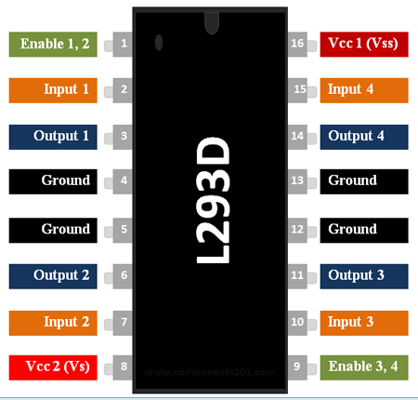
Individual Contribution-204197R
Pin Number | Pin Name | Description
1 | Enable 1,2 | This pin enables the input pin Input 1 and Input 2
2 | Input 1 | Directly controls the Output 1 pin. Controlled by the microcontroller through CD4052 demux IC.
3 | Output 1 | Connected to one end of bobbin measuring unit’ stepper motor.
4 | Ground | Ground pins are connected to the ground of the power supply.
5 | Ground | Ground pins are connected to the ground of the power supply.
6 | Output 2 | Connected to one end of bobbin measuring unit’ stepper motor.
7 | Input 2 | Directly controls the Output 2 pin. Controlled by the microcontroller through CD4052 demux IC.
8 | Vcc2 (Vs) | Connected to Voltage pin for running motors (4.5V to 36V)
L293D motor driver IC- Pinout
Notes:
These are my responsibilities for the project. I was aware of how to get the measurement of a selected bobbin. For that purpose, I used the 3 Ultrasonic sensors and a stepper motor. For the winding purpose, we want to know whether the selected bobbin is suited or not. Two ultrasonic sensors are used to measure the width of the bobbin and measure edge height of the bobbin. And Another sensor was used to measure the length of the bobbin with aid of a stepper motor. Also, I Learned to code atmega32 microcontroller using Atmel studio Software and learned to use Proteus software to simulate the circuit. I was aware of the working mechanism and pins of all the components that I have used. I did the Ultrasonic sensors and stepper motor coding part and simulated the circuit using proteus software. I drew the schematic diagram and PCB design of those components.

Slide 51
Individual Contribution-204197R
9 | Enable 3,4 | This pin enables the input pin Input 3(10) and Input 4(15)
10 | Input 3 | Directly controls the Output 3 pin. Controlled by the microcontroller through CD4052 demux IC.
11 | Output 3 | Connected to one end of bobbin measuring unit’ stepper motor.
12 | Ground | Ground pins are connected to the ground of the power supply.
13 | Ground | Ground pins are connected to the ground of the power supply.
14 | Output 4 | Connected to one end of bobbin measuring unit’ stepper motor.
15 | Input 4 | Directly controls the Output 4 pin. Controlled by the microcontroller through CD4052 demux IC.
16 | Vcc2 (Vss) | Connected to +5V to enable IC function
L293D motor driver IC- Pinout
Notes:
These are my responsibilities for the project. I was aware of how to get the measurement of a selected bobbin. For that purpose, I used the 3 Ultrasonic sensors and a stepper motor. For the winding purpose, we want to know whether the selected bobbin is suited or not. Two ultrasonic sensors are used to measure the width of the bobbin and measure edge height of the bobbin. And Another sensor was used to measure the length of the bobbin with aid of a stepper motor. Also, I Learned to code atmega32 microcontroller using Atmel studio Software and learned to use Proteus software to simulate the circuit. I was aware of the working mechanism and pins of all the components that I have used. I did the Ultrasonic sensors and stepper motor coding part and simulated the circuit using proteus software. I drew the schematic diagram and PCB design of those components.

Slide 52
Individual Contribution-204197R
Specifications - L293D motor driver IC
Wide Supply-Voltage Range: 4.5 V to 36 V
Separate Input-Logic Supply
Internal ESD Protection
High-Noise-Immunity Inputs
Output Current 600 mA Per Channel
Peak Output Current 1.2 A Per Channel
Output Clamp Diodes for Inductive Transient Suppression
Operation Temperature 0°C to 70°C.
Automatic thermal shutdown is available
Notes:
These are my responsibilities for the project. I was aware of how to get the measurement of a selected bobbin. For that purpose, I used the 3 Ultrasonic sensors and a stepper motor. For the winding purpose, we want to know whether the selected bobbin is suited or not. Two ultrasonic sensors are used to measure the width of the bobbin and measure edge height of the bobbin. And Another sensor was used to measure the length of the bobbin with aid of a stepper motor. Also, I Learned to code atmega32 microcontroller using Atmel studio Software and learned to use Proteus software to simulate the circuit. I was aware of the working mechanism and pins of all the components that I have used. I did the Ultrasonic sensors and stepper motor coding part and simulated the circuit using proteus software. I drew the schematic diagram and PCB design of those components.

Slide 53
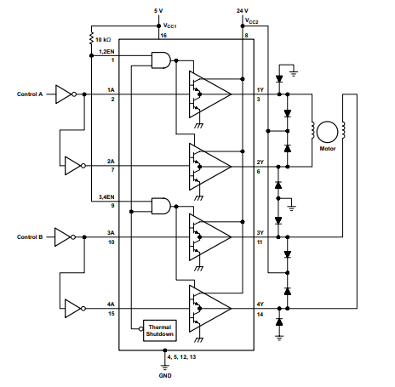
Individual Contribution-204197R
The internal circuit of the L293D Motor Driver IC
Data sheet-https://components101.com/sites/default/files/component_datasheet/L293D%20Datasheet.pdf
Notes:
These are my responsibilities for the project. I was aware of how to get the measurement of a selected bobbin. For that purpose, I used the 3 Ultrasonic sensors and a stepper motor. For the winding purpose, we want to know whether the selected bobbin is suited or not. Two ultrasonic sensors are used to measure the width of the bobbin and measure edge height of the bobbin. And Another sensor was used to measure the length of the bobbin with aid of a stepper motor. Also, I Learned to code atmega32 microcontroller using Atmel studio Software and learned to use Proteus software to simulate the circuit. I was aware of the working mechanism and pins of all the components that I have used. I did the Ultrasonic sensors and stepper motor coding part and simulated the circuit using proteus software. I drew the schematic diagram and PCB design of those components.

Slide 54
Individual Contribution-204197R
Technique for the bobbin measuring unit
User must place the bobbin on the left corner
u1 ultrasonic sensor moves to the left with aid of a stepper motor and thread bars to measure the distance(Z₁) to the wall
Stepper motor works until the above-measured distance is less than a fixed distance (this fixed value(Z₁) is included in the code). If the above-measured distance is less than that fixed value, then the motor stopped and gets the Z₂ distance.
Then the u3 ultrasonic sensor measures the edge height of the bobbin (X₃ distance) and the u2 ultrasonic sensor measures the X₂ distance respectively
User rotates the bobbin
Then the u3 ultrasonic sensor measures the Y₃ distance and the u2 ultrasonic sensor measures the Y₂ distance respectively
Using the above measurements displayed whether that selected bobbin is suited for the winding process
Notes:
These are my responsibilities for the project. I was aware of how to get the measurement of a selected bobbin. For that purpose, I used the 3 Ultrasonic sensors and a stepper motor. For the winding purpose, we want to know whether the selected bobbin is suited or not. Two ultrasonic sensors are used to measure the width of the bobbin and measure edge height of the bobbin. And Another sensor was used to measure the length of the bobbin with aid of a stepper motor. Also, I Learned to code atmega32 microcontroller using Atmel studio Software and learned to use Proteus software to simulate the circuit. I was aware of the working mechanism and pins of all the components that I have used. I did the Ultrasonic sensors and stepper motor coding part and simulated the circuit using proteus software. I drew the schematic diagram and PCB design of those components.

Slide 55
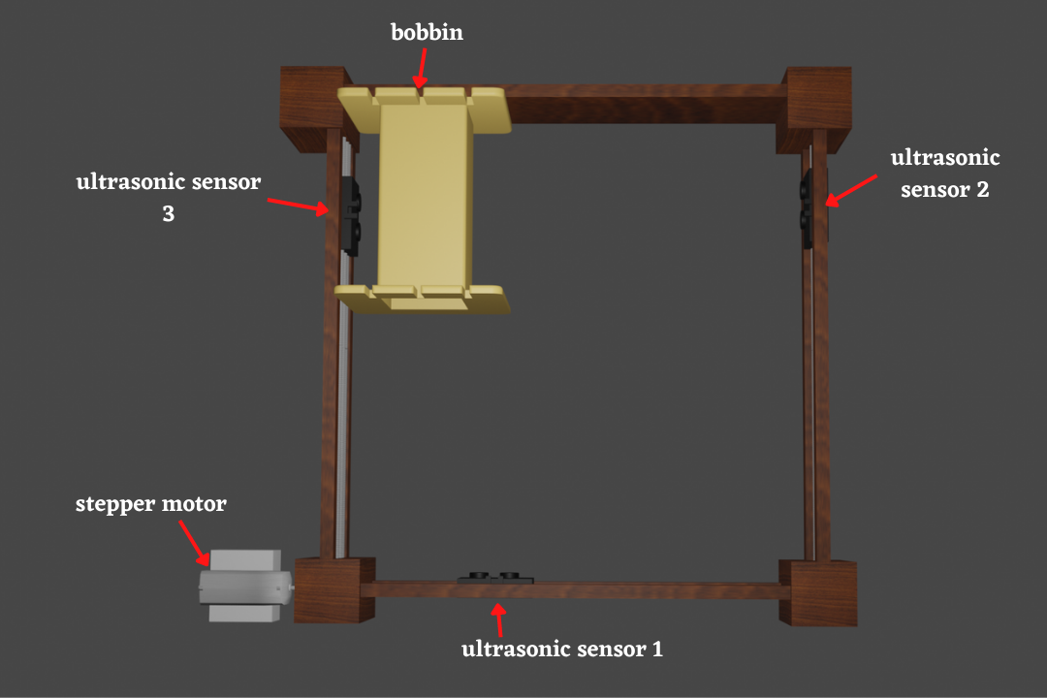
Individual Contribution-204197R
Notes:
These are my responsibilities for the project. I was aware of how to get the measurement of a selected bobbin. For that purpose, I used the 3 Ultrasonic sensors and a stepper motor. For the winding purpose, we want to know whether the selected bobbin is suited or not. Two ultrasonic sensors are used to measure the width of the bobbin and measure edge height of the bobbin. And Another sensor was used to measure the length of the bobbin with aid of a stepper motor. Also, I Learned to code atmega32 microcontroller using Atmel studio Software and learned to use Proteus software to simulate the circuit. I was aware of the working mechanism and pins of all the components that I have used. I did the Ultrasonic sensors and stepper motor coding part and simulated the circuit using proteus software. I drew the schematic diagram and PCB design of those components.

Slide 56
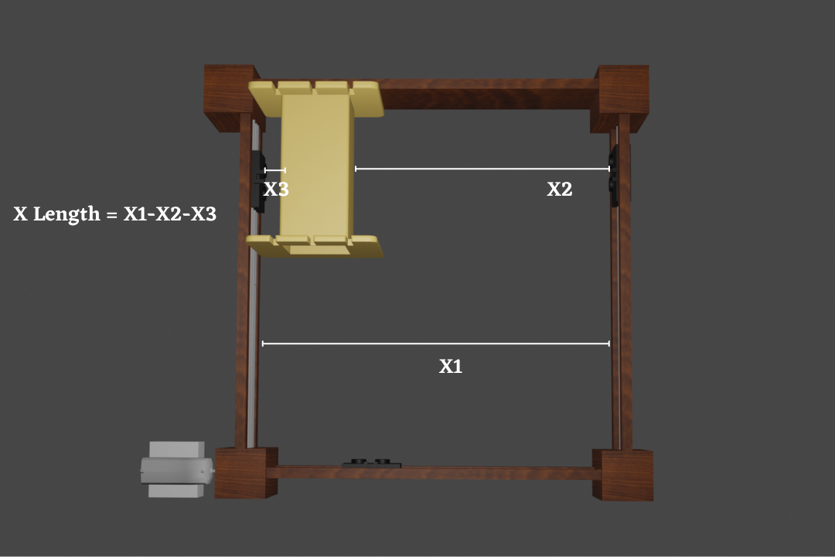
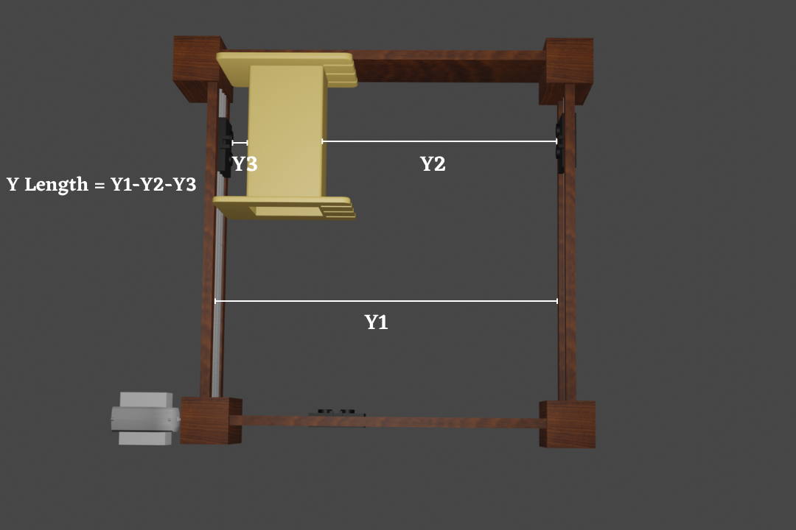
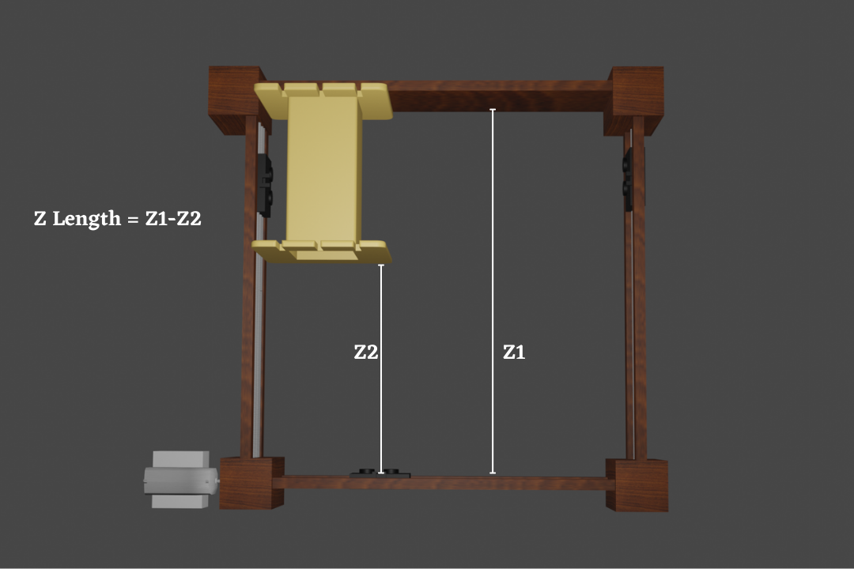
Individual Contribution-204197R

Slide 57
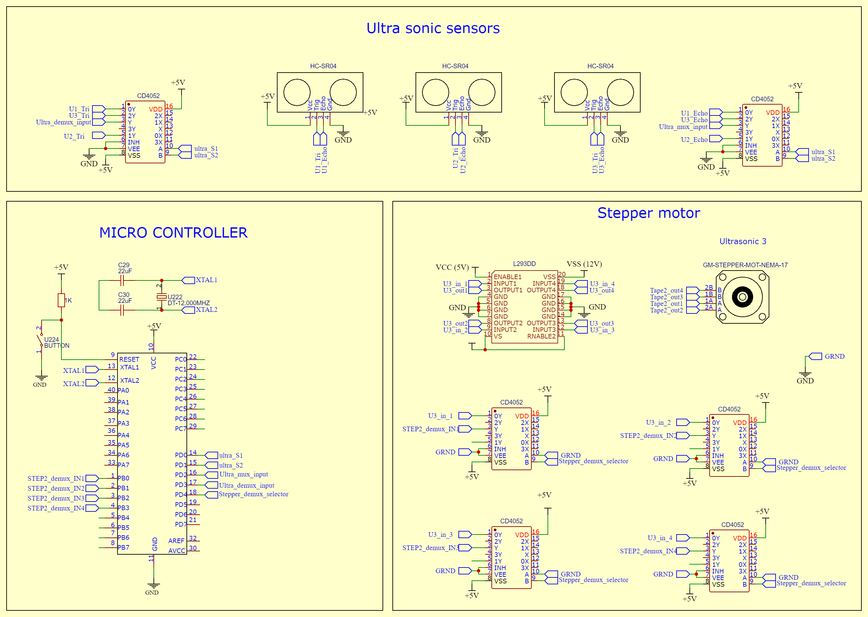
Individual Contribution-204197R
Schematic diagram
Notes:
These are my responsibilities for the project. I was aware of how to get the measurement of a selected bobbin. For that purpose, I used the 3 Ultrasonic sensors and a stepper motor. For the winding purpose, we want to know whether the selected bobbin is suited or not. Two ultrasonic sensors are used to measure the width of the bobbin and measure edge height of the bobbin. And Another sensor was used to measure the length of the bobbin with aid of a stepper motor. Also, I Learned to code atmega32 microcontroller using Atmel studio Software and learned to use Proteus software to simulate the circuit. I was aware of the working mechanism and pins of all the components that I have used. I did the Ultrasonic sensors and stepper motor coding part and simulated the circuit using proteus software. I drew the schematic diagram and PCB design of those components.

Slide 58
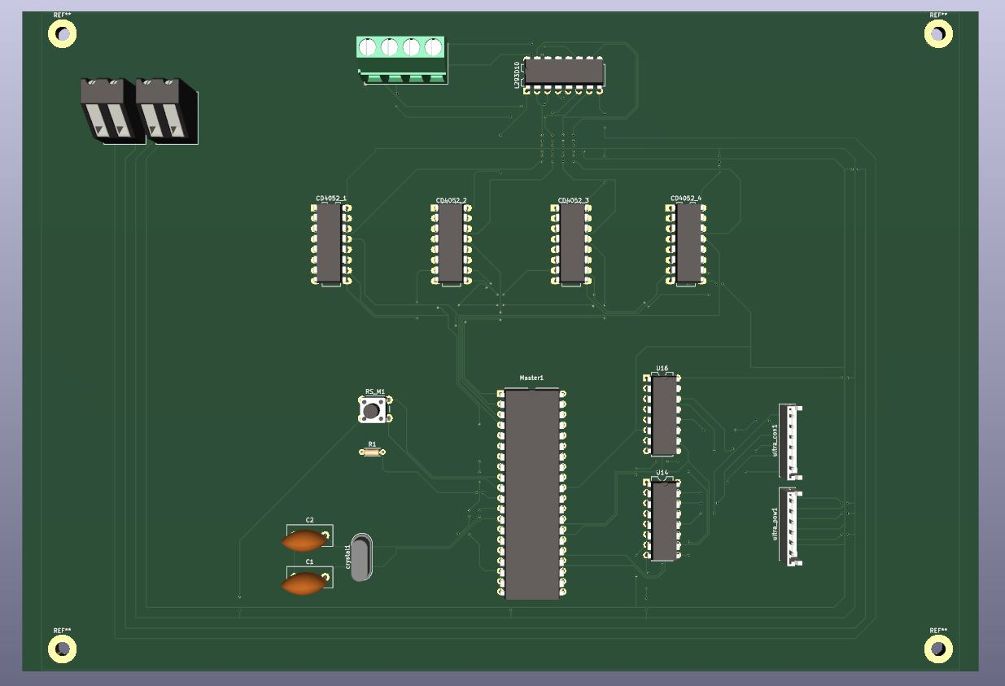
Individual Contribution-204197R
PCB design
Notes:
These are my responsibilities for the project. I was aware of how to get the measurement of a selected bobbin. For that purpose, I used the 3 Ultrasonic sensors and a stepper motor. For the winding purpose, we want to know whether the selected bobbin is suited or not. Two ultrasonic sensors are used to measure the width of the bobbin and measure edge height of the bobbin. And Another sensor was used to measure the length of the bobbin with aid of a stepper motor. Also, I Learned to code atmega32 microcontroller using Atmel studio Software and learned to use Proteus software to simulate the circuit. I was aware of the working mechanism and pins of all the components that I have used. I did the Ultrasonic sensors and stepper motor coding part and simulated the circuit using proteus software. I drew the schematic diagram and PCB design of those components.

Slide 59
Individual Contribution-204197R
Proteus Simulation
Notes:
These are my responsibilities for the project. I was aware of how to get the measurement of a selected bobbin. For that purpose, I used the 3 Ultrasonic sensors and a stepper motor. For the winding purpose, we want to know whether the selected bobbin is suited or not. Two ultrasonic sensors are used to measure the width of the bobbin and measure edge height of the bobbin. And Another sensor was used to measure the length of the bobbin with aid of a stepper motor. Also, I Learned to code atmega32 microcontroller using Atmel studio Software and learned to use Proteus software to simulate the circuit. I was aware of the working mechanism and pins of all the components that I have used. I did the Ultrasonic sensors and stepper motor coding part and simulated the circuit using proteus software. I drew the schematic diagram and PCB design of those components.

Slide 60
Individual Contribution-204189U
Member 3– 204189U Sanjaya B.H.
Responsibilities – Winding Unit
My responsibility is to design and implement the winding unit to do the winding part of the transformer winding process . In the winding process, I have designed and used 2 robotic hands to guide the copper wires along the bobbin and 2 robotic hands to guide the tape along the bobbin in winding process. Each hand has one stepper motor and servo motor. Totally there are 4 stepper motors and 4 servo motors in robotic hands. Then I have designed and used another separate unit for the tapping process. There are 2 stepper motors used in that unit for the tapping purpose. Also I have the responsibility to synchronize all these hands’ movement with the bobbin rotation. Then we have used 4 demultiplexers to connect all these stepper motors and 1 demultiplexer to the all-servo motors. I was aware of the working mechanism and pins of all the components that I have used. I did the stepper motor and servo motor coding part and simulated the circuit using proteus software. I drew the schematic diagram and PCB design of those components.
Notes:
These are my responsibilities for the project. I was aware of how to get the measurement of a selected bobbin. For that purpose, I used the 3 Ultrasonic sensors and a stepper motor. For the winding purpose, we want to know whether the selected bobbin is suited or not. Two ultrasonic sensors are used to measure the width of the bobbin and measure edge height of the bobbin. And Another sensor was used to measure the length of the bobbin with aid of a stepper motor. Also, I Learned to code atmega32 microcontroller using Atmel studio Software and learned to use Proteus software to simulate the circuit. I was aware of the working mechanism and pins of all the components that I have used. I did the Ultrasonic sensors and stepper motor coding part and simulated the circuit using proteus software. I drew the schematic diagram and PCB design of those components.

Slide 61
Individual Contribution-204189U
Technique – NEMA 17 bipolar stepper motor
Motor has a stationary part (the stator) and a moving part (the rotor).
On the stator, there are teeth on which coils are wired.
The rotor is either a permanent magnet or a variable reluctance iron core.
By energizing one or more of the stator phases, a magnetic field is generated by the current flowing in the coil and the rotor aligns with this field.
By supplying different phases in sequence, the rotor can be rotated by a specific amount to reach the desired final position.
Notes:
These are my responsibilities for the project. I was aware of how to get the measurement of a selected bobbin. For that purpose, I used the 3 Ultrasonic sensors and a stepper motor. For the winding purpose, we want to know whether the selected bobbin is suited or not. Two ultrasonic sensors are used to measure the width of the bobbin and measure edge height of the bobbin. And Another sensor was used to measure the length of the bobbin with aid of a stepper motor. Also, I Learned to code atmega32 microcontroller using Atmel studio Software and learned to use Proteus software to simulate the circuit. I was aware of the working mechanism and pins of all the components that I have used. I did the Ultrasonic sensors and stepper motor coding part and simulated the circuit using proteus software. I drew the schematic diagram and PCB design of those components.

Slide 62
Individual Contribution-204189U
NEMA 17 bipolar stepper motor Pinout
Notes:
These are my responsibilities for the project. I was aware of how to get the measurement of a selected bobbin. For that purpose, I used the 3 Ultrasonic sensors and a stepper motor. For the winding purpose, we want to know whether the selected bobbin is suited or not. Two ultrasonic sensors are used to measure the width of the bobbin and measure edge height of the bobbin. And Another sensor was used to measure the length of the bobbin with aid of a stepper motor. Also, I Learned to code atmega32 microcontroller using Atmel studio Software and learned to use Proteus software to simulate the circuit. I was aware of the working mechanism and pins of all the components that I have used. I did the Ultrasonic sensors and stepper motor coding part and simulated the circuit using proteus software. I drew the schematic diagram and PCB design of those components.

Slide 63
Individual Contribution-204189U
Specifications -NEMA 17 bipolar stepper motor
Voltage | 4V
Rated Current/phase | 0.95A
Step Angle | 1.8°
No. of Phases | 4
Phase Resistance | 3.3ohm
Inductance | 4mH
Length | 33mm
Rotor Inertia | 35g-cm²
Shaft Diameter | Φ5mm
Shaft Length | 22mm
Frame size | 42 x 42mm
Unipolar Holding Torque | 2.59kg-cm(36oz-in)
Notes:
These are my responsibilities for the project. I was aware of how to get the measurement of a selected bobbin. For that purpose, I used the 3 Ultrasonic sensors and a stepper motor. For the winding purpose, we want to know whether the selected bobbin is suited or not. Two ultrasonic sensors are used to measure the width of the bobbin and measure edge height of the bobbin. And Another sensor was used to measure the length of the bobbin with aid of a stepper motor. Also, I Learned to code atmega32 microcontroller using Atmel studio Software and learned to use Proteus software to simulate the circuit. I was aware of the working mechanism and pins of all the components that I have used. I did the Ultrasonic sensors and stepper motor coding part and simulated the circuit using proteus software. I drew the schematic diagram and PCB design of those components.

Slide 64
Individual Contribution-204189U
The internal circuit of the stepper motor
Data sheet-https://datasheetspdf.com/pdf-file/1260602/Schneider/NEMA17/1
Notes:
These are my responsibilities for the project. I was aware of how to get the measurement of a selected bobbin. For that purpose, I used the 3 Ultrasonic sensors and a stepper motor. For the winding purpose, we want to know whether the selected bobbin is suited or not. Two ultrasonic sensors are used to measure the width of the bobbin and measure edge height of the bobbin. And Another sensor was used to measure the length of the bobbin with aid of a stepper motor. Also, I Learned to code atmega32 microcontroller using Atmel studio Software and learned to use Proteus software to simulate the circuit. I was aware of the working mechanism and pins of all the components that I have used. I did the Ultrasonic sensors and stepper motor coding part and simulated the circuit using proteus software. I drew the schematic diagram and PCB design of those components.

Slide 65
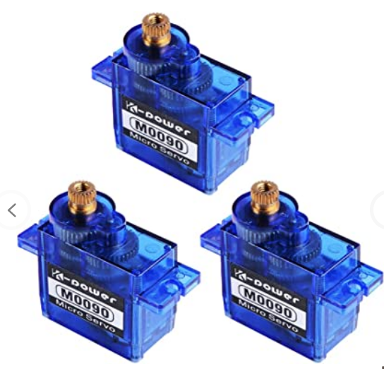
Individual Contribution-204189U
Technique – SG90 Servo motor
Servo Motor is consisted with dc motor, gear assembly and feedback control circuit.
PWM signal is used to control the servo motor.
Servo feedback control circuitry uses comparator which compares the control signal (PWM) and potentiometer reference signal to generate signal.
DC motor shaft is attached to the potentiometer shaft through the gear assembly.
Then rotating DC motor rotates potentiometer.
When the both potentiometer signal and control signal match at a point, , DC motor will stop.
Notes:
These are my responsibilities for the project. I was aware of how to get the measurement of a selected bobbin. For that purpose, I used the 3 Ultrasonic sensors and a stepper motor. For the winding purpose, we want to know whether the selected bobbin is suited or not. Two ultrasonic sensors are used to measure the width of the bobbin and measure edge height of the bobbin. And Another sensor was used to measure the length of the bobbin with aid of a stepper motor. Also, I Learned to code atmega32 microcontroller using Atmel studio Software and learned to use Proteus software to simulate the circuit. I was aware of the working mechanism and pins of all the components that I have used. I did the Ultrasonic sensors and stepper motor coding part and simulated the circuit using proteus software. I drew the schematic diagram and PCB design of those components.

Slide 66
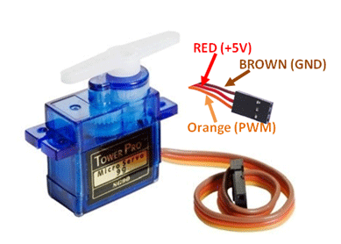
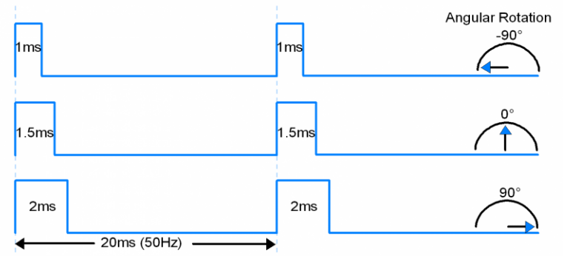
Individual Contribution-204189U
SG90 Servo motor Pinout
Notes:
These are my responsibilities for the project. I was aware of how to get the measurement of a selected bobbin. For that purpose, I used the 3 Ultrasonic sensors and a stepper motor. For the winding purpose, we want to know whether the selected bobbin is suited or not. Two ultrasonic sensors are used to measure the width of the bobbin and measure edge height of the bobbin. And Another sensor was used to measure the length of the bobbin with aid of a stepper motor. Also, I Learned to code atmega32 microcontroller using Atmel studio Software and learned to use Proteus software to simulate the circuit. I was aware of the working mechanism and pins of all the components that I have used. I did the Ultrasonic sensors and stepper motor coding part and simulated the circuit using proteus software. I drew the schematic diagram and PCB design of those components.

Slide 67
Individual Contribution-204189U
Specifications - SG90 Servo motor
Voltage | 4.8 – 5V
Weight | 9g
Dimension | 22.2 x 11.8 x 31 mm approx.
Stall torque | 1.8 kgf·cm
Operating speed | 0.1 s/60 degree
Dead band width | 10 μs
Temperature range | 0 ºC – 55 ºC
Notes:
These are my responsibilities for the project. I was aware of how to get the measurement of a selected bobbin. For that purpose, I used the 3 Ultrasonic sensors and a stepper motor. For the winding purpose, we want to know whether the selected bobbin is suited or not. Two ultrasonic sensors are used to measure the width of the bobbin and measure edge height of the bobbin. And Another sensor was used to measure the length of the bobbin with aid of a stepper motor. Also, I Learned to code atmega32 microcontroller using Atmel studio Software and learned to use Proteus software to simulate the circuit. I was aware of the working mechanism and pins of all the components that I have used. I did the Ultrasonic sensors and stepper motor coding part and simulated the circuit using proteus software. I drew the schematic diagram and PCB design of those components.

Slide 68
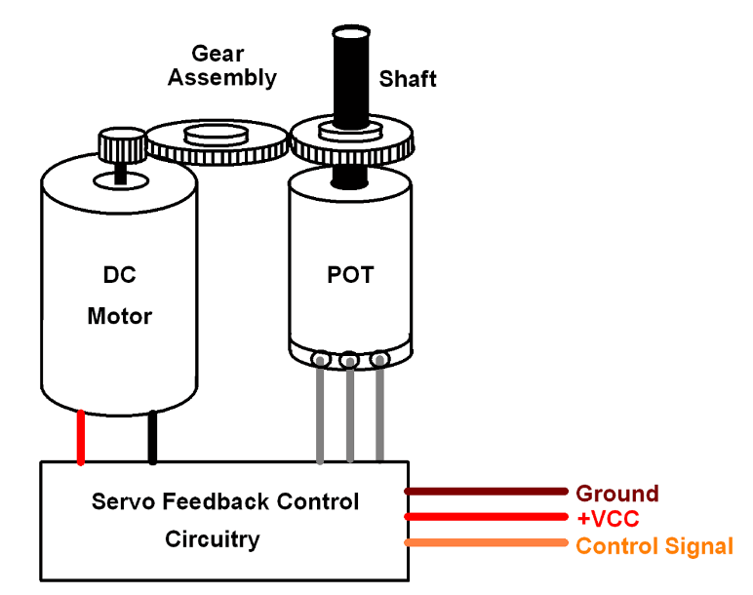
Individual Contribution-204189U
The internal diagram of the Servo motor
Data sheet-https://datasheetspdf.com/pdf-file/791970/TowerPro/SG90/1
Notes:
These are my responsibilities for the project. I was aware of how to get the measurement of a selected bobbin. For that purpose, I used the 3 Ultrasonic sensors and a stepper motor. For the winding purpose, we want to know whether the selected bobbin is suited or not. Two ultrasonic sensors are used to measure the width of the bobbin and measure edge height of the bobbin. And Another sensor was used to measure the length of the bobbin with aid of a stepper motor. Also, I Learned to code atmega32 microcontroller using Atmel studio Software and learned to use Proteus software to simulate the circuit. I was aware of the working mechanism and pins of all the components that I have used. I did the Ultrasonic sensors and stepper motor coding part and simulated the circuit using proteus software. I drew the schematic diagram and PCB design of those components.

Slide 69
Individual Contribution-204189U
Technique:- L293D motor driver IC
low voltage operating device.
provides the continuous bidirectional Direct Current to the Motor.
has an internal H-bridge installed for a single stepper motor.
H-Bridge is an electrical circuit that enables the load in a bidirectional way.
It could control any motor speed and direction with a voltage range of 4.5 – 36 Volts
Notes:
These are my responsibilities for the project. I was aware of how to get the measurement of a selected bobbin. For that purpose, I used the 3 Ultrasonic sensors and a stepper motor. For the winding purpose, we want to know whether the selected bobbin is suited or not. Two ultrasonic sensors are used to measure the width of the bobbin and measure edge height of the bobbin. And Another sensor was used to measure the length of the bobbin with aid of a stepper motor. Also, I Learned to code atmega32 microcontroller using Atmel studio Software and learned to use Proteus software to simulate the circuit. I was aware of the working mechanism and pins of all the components that I have used. I did the Ultrasonic sensors and stepper motor coding part and simulated the circuit using proteus software. I drew the schematic diagram and PCB design of those components.

Slide 70
Individual Contribution-204189U
Pin Number | Pin Name | Description
1 | Enable 1,2 | This pin enables the input pin Input 1 and Input 2
2 | Input 1 | Directly controls the Output 1 pin.
3 | Output 1 | Connected to one pin of stepper motor.
4 | Ground | Ground pins are connected to the ground of the power supply.
5 | Ground | Ground pins are connected to the ground of the power supply.
6 | Output 2 | Connected to one pin of stepper motor.
7 | Input 2 | Directly controls the Output 2 pin.
8 | Vcc2 (Vs) | Connected to Voltage pin for running motors (4.5V to 36V)
L293D motor driver IC- Pinout
Notes:
These are my responsibilities for the project. I was aware of how to get the measurement of a selected bobbin. For that purpose, I used the 3 Ultrasonic sensors and a stepper motor. For the winding purpose, we want to know whether the selected bobbin is suited or not. Two ultrasonic sensors are used to measure the width of the bobbin and measure edge height of the bobbin. And Another sensor was used to measure the length of the bobbin with aid of a stepper motor. Also, I Learned to code atmega32 microcontroller using Atmel studio Software and learned to use Proteus software to simulate the circuit. I was aware of the working mechanism and pins of all the components that I have used. I did the Ultrasonic sensors and stepper motor coding part and simulated the circuit using proteus software. I drew the schematic diagram and PCB design of those components.

Slide 71
Individual Contribution-204189U
9 | Enable 3,4 | This pin enables the input pin Input 3(10) and Input 4(15)
10 | Input 3 | Directly controls the Output 3 pin.
11 | Output 3 | Connected to one pin of stepper motor.
12 | Ground | Ground pins are connected to the ground of the power supply.
13 | Ground | Ground pins are connected to the ground of the power supply.
14 | Output 4 | Connected to one pin of stepper motor.
15 | Input 4 | Directly controls the Output 4 pin.
16 | Vcc2 (Vss) | Connected to +5V to enable IC function
L293D motor driver IC- Pinout
Notes:
These are my responsibilities for the project. I was aware of how to get the measurement of a selected bobbin. For that purpose, I used the 3 Ultrasonic sensors and a stepper motor. For the winding purpose, we want to know whether the selected bobbin is suited or not. Two ultrasonic sensors are used to measure the width of the bobbin and measure edge height of the bobbin. And Another sensor was used to measure the length of the bobbin with aid of a stepper motor. Also, I Learned to code atmega32 microcontroller using Atmel studio Software and learned to use Proteus software to simulate the circuit. I was aware of the working mechanism and pins of all the components that I have used. I did the Ultrasonic sensors and stepper motor coding part and simulated the circuit using proteus software. I drew the schematic diagram and PCB design of those components.

Slide 72
Individual Contribution-204189U
Specifications - L293D motor driver IC
Wide Supply-Voltage Range: 4.5 V to 36 V
Separate Input-Logic Supply
Internal ESD Protection
High-Noise-Immunity Inputs
Output Current 600 mA Per Channel
Peak Output Current 1.2 A Per Channel
Output Clamp Diodes for Inductive Transient Suppression
Operation Temperature 0°C to 70°C.
Automatic thermal shutdown is available
Notes:
These are my responsibilities for the project. I was aware of how to get the measurement of a selected bobbin. For that purpose, I used the 3 Ultrasonic sensors and a stepper motor. For the winding purpose, we want to know whether the selected bobbin is suited or not. Two ultrasonic sensors are used to measure the width of the bobbin and measure edge height of the bobbin. And Another sensor was used to measure the length of the bobbin with aid of a stepper motor. Also, I Learned to code atmega32 microcontroller using Atmel studio Software and learned to use Proteus software to simulate the circuit. I was aware of the working mechanism and pins of all the components that I have used. I did the Ultrasonic sensors and stepper motor coding part and simulated the circuit using proteus software. I drew the schematic diagram and PCB design of those components.

Slide 73
Individual Contribution-204189U
The internal circuit of the L293D Motor Driver IC
Data sheet-https://components101.com/sites/default/files/component_datasheet/L293D%20Datasheet.pdf
Notes:
These are my responsibilities for the project. I was aware of how to get the measurement of a selected bobbin. For that purpose, I used the 3 Ultrasonic sensors and a stepper motor. For the winding purpose, we want to know whether the selected bobbin is suited or not. Two ultrasonic sensors are used to measure the width of the bobbin and measure edge height of the bobbin. And Another sensor was used to measure the length of the bobbin with aid of a stepper motor. Also, I Learned to code atmega32 microcontroller using Atmel studio Software and learned to use Proteus software to simulate the circuit. I was aware of the working mechanism and pins of all the components that I have used. I did the Ultrasonic sensors and stepper motor coding part and simulated the circuit using proteus software. I drew the schematic diagram and PCB design of those components.

Slide 74
Individual Contribution-204189U
Technique:- CD4052 DEMUX IC
Can be used as a 1:4 Demultiplexer.
Take inputs from 1-channel and send them to separate channel from four channels based on the channel select pins.
Input pins will be X and Y.
The output pins can either be X0, Y0 or X1, Y1 or X2, Y2 or X3, Y3 based on the value set on A and B pins.
The state of the select pins and channel selection is shown in the table.
A | B | Channel Selected
0 | 0 | Channel 0
1 | 0 | Channel 1
0 | 1 | Channel 2
1 | 1 | Channel 3
Notes:
These are my responsibilities for the project. I was aware of how to get the measurement of a selected bobbin. For that purpose, I used the 3 Ultrasonic sensors and a stepper motor. For the winding purpose, we want to know whether the selected bobbin is suited or not. Two ultrasonic sensors are used to measure the width of the bobbin and measure edge height of the bobbin. And Another sensor was used to measure the length of the bobbin with aid of a stepper motor. Also, I Learned to code atmega32 microcontroller using Atmel studio Software and learned to use Proteus software to simulate the circuit. I was aware of the working mechanism and pins of all the components that I have used. I did the Ultrasonic sensors and stepper motor coding part and simulated the circuit using proteus software. I drew the schematic diagram and PCB design of those components.

Slide 75
Individual Contribution-204189U
CD4052 DEMUX IC Pinout
Pin Number | Pin Name | Description
16 | Vdd | Positive power input, maximum 20V
7 | Vee | Negative power rail, normally connected to ground
8 | Vss (Ground) | Connected to ground of the circuit
6 | INH | Enable pin – Must be pulled to ground for normal operation
9,10 | A,B | Channel Select pins
1,12 | Y0,X0 | Channel 0 Input / Output
5,14 | Y1,X1 | Channel 1 Input / Output
2,15 | Y2,X2 | Channel 2 Input / Output
4,11 | Y3,X3 | Channel 3 Input / Output
3,13 | Y,X | Common Output / Input
Notes:
These are my responsibilities for the project. I was aware of how to get the measurement of a selected bobbin. For that purpose, I used the 3 Ultrasonic sensors and a stepper motor. For the winding purpose, we want to know whether the selected bobbin is suited or not. Two ultrasonic sensors are used to measure the width of the bobbin and measure edge height of the bobbin. And Another sensor was used to measure the length of the bobbin with aid of a stepper motor. Also, I Learned to code atmega32 microcontroller using Atmel studio Software and learned to use Proteus software to simulate the circuit. I was aware of the working mechanism and pins of all the components that I have used. I did the Ultrasonic sensors and stepper motor coding part and simulated the circuit using proteus software. I drew the schematic diagram and PCB design of those components.

Slide 76
Individual Contribution-204189U
Specifications - CD4052 DEMUX IC
Dual 4 Channel Analog Multiplexer or Demultiplexer
Supply Voltage Range: 3 to 15V
Input Current: ±10mA
Power Dissipation: 750mW
Low-level Input Voltage Max.: 1.5V
High-level Input Voltage Min.: 3.5V
On State Resistance Max.: 2500Ω
Propagation Delay Time Max.: 305ns
Min Operating Temperature: -55°C
Max Operating Temperature: 125°C
Notes:
These are my responsibilities for the project. I was aware of how to get the measurement of a selected bobbin. For that purpose, I used the 3 Ultrasonic sensors and a stepper motor. For the winding purpose, we want to know whether the selected bobbin is suited or not. Two ultrasonic sensors are used to measure the width of the bobbin and measure edge height of the bobbin. And Another sensor was used to measure the length of the bobbin with aid of a stepper motor. Also, I Learned to code atmega32 microcontroller using Atmel studio Software and learned to use Proteus software to simulate the circuit. I was aware of the working mechanism and pins of all the components that I have used. I did the Ultrasonic sensors and stepper motor coding part and simulated the circuit using proteus software. I drew the schematic diagram and PCB design of those components.

Slide 77
Individual Contribution-204189U
The internal circuit of the CD4052 IC
Data sheet-https://components101.com/sites/default/files/component_datasheet/CD4052-Datasheet.pdf
Notes:
These are my responsibilities for the project. I was aware of how to get the measurement of a selected bobbin. For that purpose, I used the 3 Ultrasonic sensors and a stepper motor. For the winding purpose, we want to know whether the selected bobbin is suited or not. Two ultrasonic sensors are used to measure the width of the bobbin and measure edge height of the bobbin. And Another sensor was used to measure the length of the bobbin with aid of a stepper motor. Also, I Learned to code atmega32 microcontroller using Atmel studio Software and learned to use Proteus software to simulate the circuit. I was aware of the working mechanism and pins of all the components that I have used. I did the Ultrasonic sensors and stepper motor coding part and simulated the circuit using proteus software. I drew the schematic diagram and PCB design of those components.

Slide 78
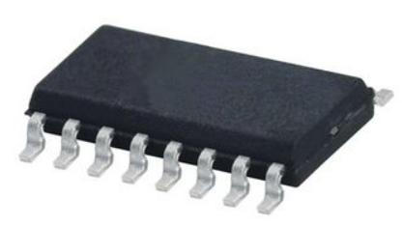
Individual Contribution-204189U
Technique:- CD74HC4051 IC
Can be used as a 1:8 Demultiplexer.
Take inputs from 1-channel and send them to separate channel from eight channels based on the channel select pins.
Common Input pin will be Z.
The output pin can either be Y0, Y1, Y2, Y3, Y4, Y5, Y6, Y7 based on the value set on S0, S1 and S2 pins.
The state of the select pins and channel selection is shown in the table.
S0 | S1 | S2 | Channel Selected
0 | 0 | 0 | Channel 0
0 | 0 | 1 | Channel 1
0 | 1 | 0 | Channel 2
0 | 1 | 1 | Channel 3
1 | 0 | 0 | Channel 4
1 | 0 | 1 | Channel 5
1 | 1 | 0 | Channel 6
1 | 1 | 1 | Channel 7
Notes:
These are my responsibilities for the project. I was aware of how to get the measurement of a selected bobbin. For that purpose, I used the 3 Ultrasonic sensors and a stepper motor. For the winding purpose, we want to know whether the selected bobbin is suited or not. Two ultrasonic sensors are used to measure the width of the bobbin and measure edge height of the bobbin. And Another sensor was used to measure the length of the bobbin with aid of a stepper motor. Also, I Learned to code atmega32 microcontroller using Atmel studio Software and learned to use Proteus software to simulate the circuit. I was aware of the working mechanism and pins of all the components that I have used. I did the Ultrasonic sensors and stepper motor coding part and simulated the circuit using proteus software. I drew the schematic diagram and PCB design of those components.

Slide 79
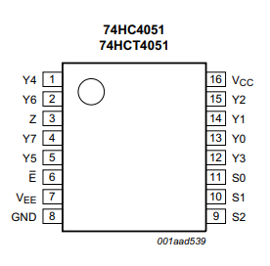
Individual Contribution-204189U
CD74HC4051 IC Pinout
Pin Number | Pin Name | Description
6 | E | Enable Input(Active Low)
7 | Vee | Supply Voltage
8 | GND | Ground Supply Voltage
11,10,9 | S0,S1,S2 | Channel Select Input
13,14,15,12,1,5,2,4 | Y0,Y1,Y2,Y3,Y4,Y5,Y6,Y7 | Channel 1 to 8 Input / Output
3 | Z | Common Output or Input
16 | Vcc | Supply Voltage
Notes:
These are my responsibilities for the project. I was aware of how to get the measurement of a selected bobbin. For that purpose, I used the 3 Ultrasonic sensors and a stepper motor. For the winding purpose, we want to know whether the selected bobbin is suited or not. Two ultrasonic sensors are used to measure the width of the bobbin and measure edge height of the bobbin. And Another sensor was used to measure the length of the bobbin with aid of a stepper motor. Also, I Learned to code atmega32 microcontroller using Atmel studio Software and learned to use Proteus software to simulate the circuit. I was aware of the working mechanism and pins of all the components that I have used. I did the Ultrasonic sensors and stepper motor coding part and simulated the circuit using proteus software. I drew the schematic diagram and PCB design of those components.

Slide 80
Individual Contribution-204189U
Specifications - CD74HC4051 IC
8 Channel Analog Multiplexer or Demultiplexer
Supply Voltage Range: -0.5 to 11V
Input Current: ±20mA
Power Dissipation: 100mW
switch clamping current : ±20mA
switch current : ±25mA
supply current (Iee): ±20mA
supply current (Icc): 50mA
Ground Current: -50mA
Min Operating Temperature: -65°C
Max Operating Temperature: 150°C
Notes:
These are my responsibilities for the project. I was aware of how to get the measurement of a selected bobbin. For that purpose, I used the 3 Ultrasonic sensors and a stepper motor. For the winding purpose, we want to know whether the selected bobbin is suited or not. Two ultrasonic sensors are used to measure the width of the bobbin and measure edge height of the bobbin. And Another sensor was used to measure the length of the bobbin with aid of a stepper motor. Also, I Learned to code atmega32 microcontroller using Atmel studio Software and learned to use Proteus software to simulate the circuit. I was aware of the working mechanism and pins of all the components that I have used. I did the Ultrasonic sensors and stepper motor coding part and simulated the circuit using proteus software. I drew the schematic diagram and PCB design of those components.

Slide 81
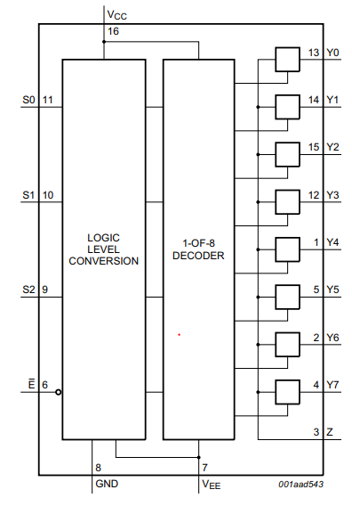
Individual Contribution-204189U
The internal circuit of the CD74HC4051 IC
Data sheet- https://www.farnell.com/datasheets/2024221.pdf
Notes:
These are my responsibilities for the project. I was aware of how to get the measurement of a selected bobbin. For that purpose, I used the 3 Ultrasonic sensors and a stepper motor. For the winding purpose, we want to know whether the selected bobbin is suited or not. Two ultrasonic sensors are used to measure the width of the bobbin and measure edge height of the bobbin. And Another sensor was used to measure the length of the bobbin with aid of a stepper motor. Also, I Learned to code atmega32 microcontroller using Atmel studio Software and learned to use Proteus software to simulate the circuit. I was aware of the working mechanism and pins of all the components that I have used. I did the Ultrasonic sensors and stepper motor coding part and simulated the circuit using proteus software. I drew the schematic diagram and PCB design of those components.

Slide 82
Individual Contribution-204189U
Technique for the Winding unit
Each robotic hand is moving along through the metal thread bar.
Each thread bar is attached to a separate stepper motor.
Each thread bar has 0.5mm pitch.
Each stepper motor has 1.8⁰ step angle.
Each stepper motor is using full step sequence in rotating.
In one sequence it completes 7.2⁰ angle.
For one revolution of thread in metal bar it needs 50 sequences in full step.
In one sequence hand is moving 0.01 mm along the thread bar.
0.01mm is the smallest wire gauge that is used in the machine.
In every bobbin rotation hand is moving equally to the gauge of wire.
Notes:
These are my responsibilities for the project. I was aware of how to get the measurement of a selected bobbin. For that purpose, I used the 3 Ultrasonic sensors and a stepper motor. For the winding purpose, we want to know whether the selected bobbin is suited or not. Two ultrasonic sensors are used to measure the width of the bobbin and measure edge height of the bobbin. And Another sensor was used to measure the length of the bobbin with aid of a stepper motor. Also, I Learned to code atmega32 microcontroller using Atmel studio Software and learned to use Proteus software to simulate the circuit. I was aware of the working mechanism and pins of all the components that I have used. I did the Ultrasonic sensors and stepper motor coding part and simulated the circuit using proteus software. I drew the schematic diagram and PCB design of those components.

Slide 83
Individual Contribution-204189U
Technique for the Winding unit
All the primary, secondary, tape arm 1 and tape arm 2 are using this technique to synchronize the moving distance with the bobbin rotation.
After the primary winding tape arms are used to cover the bobbin with insulating tape.
For that servo motors are used to bend the arms to stick the tapes and cut the tapes.
Then the secondary winding is started and at the tapping points tapping control unit do the tapping process.
In tapping control unit two stepper motors are used to move the tapping control unit and rotate the tapping wheel.
Tapping control unit is used to separate and attach the tapping point of winding to the tapping pins to get user desired voltages.
After the tapping process, again tape arms are used to cover the crossed tapping wire along the bobbin.
Notes:
These are my responsibilities for the project. I was aware of how to get the measurement of a selected bobbin. For that purpose, I used the 3 Ultrasonic sensors and a stepper motor. For the winding purpose, we want to know whether the selected bobbin is suited or not. Two ultrasonic sensors are used to measure the width of the bobbin and measure edge height of the bobbin. And Another sensor was used to measure the length of the bobbin with aid of a stepper motor. Also, I Learned to code atmega32 microcontroller using Atmel studio Software and learned to use Proteus software to simulate the circuit. I was aware of the working mechanism and pins of all the components that I have used. I did the Ultrasonic sensors and stepper motor coding part and simulated the circuit using proteus software. I drew the schematic diagram and PCB design of those components.

Slide 84
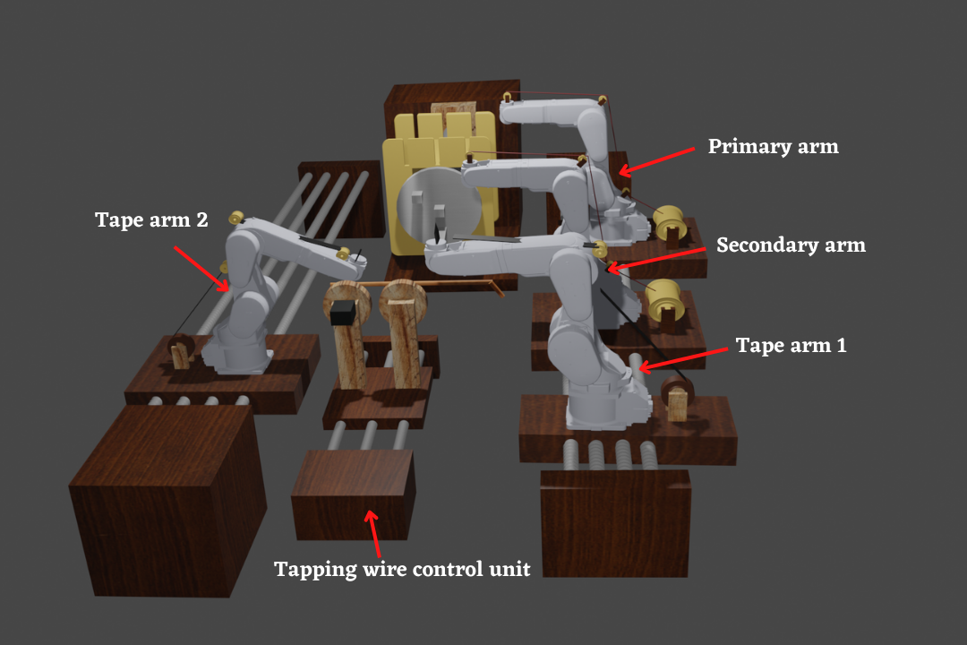
Individual Contribution-204189U
Notes:
These are my responsibilities for the project. I was aware of how to get the measurement of a selected bobbin. For that purpose, I used the 3 Ultrasonic sensors and a stepper motor. For the winding purpose, we want to know whether the selected bobbin is suited or not. Two ultrasonic sensors are used to measure the width of the bobbin and measure edge height of the bobbin. And Another sensor was used to measure the length of the bobbin with aid of a stepper motor. Also, I Learned to code atmega32 microcontroller using Atmel studio Software and learned to use Proteus software to simulate the circuit. I was aware of the working mechanism and pins of all the components that I have used. I did the Ultrasonic sensors and stepper motor coding part and simulated the circuit using proteus software. I drew the schematic diagram and PCB design of those components.

Slide 85
Individual Contribution-204189U
Notes:
These are my responsibilities for the project. I was aware of how to get the measurement of a selected bobbin. For that purpose, I used the 3 Ultrasonic sensors and a stepper motor. For the winding purpose, we want to know whether the selected bobbin is suited or not. Two ultrasonic sensors are used to measure the width of the bobbin and measure edge height of the bobbin. And Another sensor was used to measure the length of the bobbin with aid of a stepper motor. Also, I Learned to code atmega32 microcontroller using Atmel studio Software and learned to use Proteus software to simulate the circuit. I was aware of the working mechanism and pins of all the components that I have used. I did the Ultrasonic sensors and stepper motor coding part and simulated the circuit using proteus software. I drew the schematic diagram and PCB design of those components.

Slide 86

Individual Contribution-204189U
Notes:
These are my responsibilities for the project. I was aware of how to get the measurement of a selected bobbin. For that purpose, I used the 3 Ultrasonic sensors and a stepper motor. For the winding purpose, we want to know whether the selected bobbin is suited or not. Two ultrasonic sensors are used to measure the width of the bobbin and measure edge height of the bobbin. And Another sensor was used to measure the length of the bobbin with aid of a stepper motor. Also, I Learned to code atmega32 microcontroller using Atmel studio Software and learned to use Proteus software to simulate the circuit. I was aware of the working mechanism and pins of all the components that I have used. I did the Ultrasonic sensors and stepper motor coding part and simulated the circuit using proteus software. I drew the schematic diagram and PCB design of those components.

Slide 87
Individual Contribution-204189U
Notes:
These are my responsibilities for the project. I was aware of how to get the measurement of a selected bobbin. For that purpose, I used the 3 Ultrasonic sensors and a stepper motor. For the winding purpose, we want to know whether the selected bobbin is suited or not. Two ultrasonic sensors are used to measure the width of the bobbin and measure edge height of the bobbin. And Another sensor was used to measure the length of the bobbin with aid of a stepper motor. Also, I Learned to code atmega32 microcontroller using Atmel studio Software and learned to use Proteus software to simulate the circuit. I was aware of the working mechanism and pins of all the components that I have used. I did the Ultrasonic sensors and stepper motor coding part and simulated the circuit using proteus software. I drew the schematic diagram and PCB design of those components.

Slide 88

Individual Contribution-204189U
Schematic diagram
Notes:
These are my responsibilities for the project. I was aware of how to get the measurement of a selected bobbin. For that purpose, I used the 3 Ultrasonic sensors and a stepper motor. For the winding purpose, we want to know whether the selected bobbin is suited or not. Two ultrasonic sensors are used to measure the width of the bobbin and measure edge height of the bobbin. And Another sensor was used to measure the length of the bobbin with aid of a stepper motor. Also, I Learned to code atmega32 microcontroller using Atmel studio Software and learned to use Proteus software to simulate the circuit. I was aware of the working mechanism and pins of all the components that I have used. I did the Ultrasonic sensors and stepper motor coding part and simulated the circuit using proteus software. I drew the schematic diagram and PCB design of those components.

Slide 89

Individual Contribution-204189U
PCB design
Notes:
These are my responsibilities for the project. I was aware of how to get the measurement of a selected bobbin. For that purpose, I used the 3 Ultrasonic sensors and a stepper motor. For the winding purpose, we want to know whether the selected bobbin is suited or not. Two ultrasonic sensors are used to measure the width of the bobbin and measure edge height of the bobbin. And Another sensor was used to measure the length of the bobbin with aid of a stepper motor. Also, I Learned to code atmega32 microcontroller using Atmel studio Software and learned to use Proteus software to simulate the circuit. I was aware of the working mechanism and pins of all the components that I have used. I did the Ultrasonic sensors and stepper motor coding part and simulated the circuit using proteus software. I drew the schematic diagram and PCB design of those components.

Slide 90
Individual Contribution-204189U
Proteus Simulation
Notes:
These are my responsibilities for the project. I was aware of how to get the measurement of a selected bobbin. For that purpose, I used the 3 Ultrasonic sensors and a stepper motor. For the winding purpose, we want to know whether the selected bobbin is suited or not. Two ultrasonic sensors are used to measure the width of the bobbin and measure edge height of the bobbin. And Another sensor was used to measure the length of the bobbin with aid of a stepper motor. Also, I Learned to code atmega32 microcontroller using Atmel studio Software and learned to use Proteus software to simulate the circuit. I was aware of the working mechanism and pins of all the components that I have used. I did the Ultrasonic sensors and stepper motor coding part and simulated the circuit using proteus software. I drew the schematic diagram and PCB design of those components.

Slide 91
Individual Contribution-204042N
Member 4 – 204042N Dinusha K.M
Responsible part - bobbin rotation ,cutting unit and
buzzer
I have responsibilities for the bobbin rotation ,cutting unit and buzzer in our automated transform winding project. These are my responsibilities for the project. I was aware of how to get the calculating of bobbin rotation . For that purpose, I used the stepper motor. this allows us to accurately calculate the number of turns of the bobin,i used 2 stepper motor for cutting unit, one of them is to move the cutter here and there and other one to cut the wire with using a cutter And i used buzzer Also, I Learned to code atmega32 microcontroller using Atmel studio Software and learned to use Proteus software to simulate the circuit. I was aware of the working mechanism and pins of all the components that I have used. I did the stepper motor and buzzer coding part and simulated the circuit using proteus software. I drew the schematic diagram and PCB design of those components.

Slide 92
Individual Contribaution-204042N
Technique – NEMA 17 bipolar stepper motor
Motor has a stationary part (the stator) and a moving part (the rotor).
On the stator, there are teeth on which coils are wired.
The rotor is either a permanent magnet or a variable reluctance iron core.
By energizing one or more of the stator phases, a magnetic field is generated by the current flowing in the coil and the rotor aligns with this field.
By supplying different phases in sequence, the rotor can be rotated by a specific amount to reach the desired final position.

Slide 93
Individual Contribution-204042N
NEMA 17 bipolar stepper motor Pinout

Slide 94
Individual Contribution-204042N
Specifications -NEMA 17 bipolar stepper motor
Voltage | 4V
Rated Current/phase | 0.95A
Step Angle | 1.8°
No. of Phases | 4
Phase Resistance | 3.3ohm
Inductance | 4mH
Length | 33mm
Rotor Inertia | 35g-cm²
Shaft Diameter | Φ5mm
Shaft Length | 22mm
Frame size | 42 x 42mm
Unipolar Holding Torque | 2.59kg-cm(36oz-in)

Slide 95
Individual Contribution-204042N
The internal circuit of the stepper motor
Data sheet-https://datasheetspdf.com/pdf-file/1260602/Schneider/NEMA17/1

Slide 96
Individual Contribution-204042N
Technique:- CD4052 MUX/DEMUX IC
Can be used as a 4:1 Multiplexer.
Take inputs from 4-channel and convert them to single channel output based on the channel select pins.
Input channels are X0Y0, X1Y1, X2Y2 and X3 and Y3 and the single output channel is X, Y.
The output on the single channel is decided based on the channel select pins A and B.
Also, can be used as a 1:4 Demultiplexer.
Input pins will be X and Y.
The output pins can either be X0, Y0 or X1, Y1 or X2, Y2 or X3, Y3 based on the value set on A and B pins.
The state of the select pins and channel selection is shown in the table.
A | B | Channel Selected
0 | 0 | Channel 0
1 | 0 | Channel 1
0 | 1 | Channel 2
1 | 1 | Channel 3

Slide 97
Individual Contribution-204042N
CD4052 MUX/DEMUX IC Pinout
Pin Number | Pin Name | Description
16 | Vdd | Positive power input, maximum 20V
7 | Vee | Negative power rail, normally connected to ground
8 | Vss (Ground) | Connected to ground of the circuit
6 | INH | Enable pin – Must be pulled to ground for normal operation
9,10 | A,B | Channel Select pins
1,12 | Y0,X0 | Channel 0 Input / Output
5,14 | Y1,X1 | Channel 1 Input / Output
2,15 | Y2,X2 | Channel 2 Input / Output
4,11 | Y3,X3 | Channel 3 Input / Output
3,13 | Y,X | Common Output / Input

Slide 98
Individual Contribution-204042N
Specifications - CD4052 MUX/DEMUX IC
Dual 4 Channel Analog Multiplexer or Demultiplexer
Supply Voltage Range: 3 to 15V
Input Current: ±10mA
Power Dissipation: 750mW
Low-level Input Voltage Max.: 1.5V
High-level Input Voltage Min.: 3.5V
On State Resistance Max.: 2500Ω
Propagation Delay Time Max.: 305ns
Min Operating Temperature: -55°C
Max Operating Temperature: 125°C

Slide 99
Individual Contribution-204042N
The internal circuit of the CD4052 IC
Data sheet-https://components101.com/sites/default/files/component_datasheet/CD4052-Datasheet.pdf

Slide 100
Individual Contribution-204042N
Technique:- CD74HC4051 IC
Can be used as a 1:8 Demultiplexer.
Take inputs from 1-channel and send them to separate channel from eight channels based on the channel select pins.
Common Input pin will be Z.
The output pin can either be Y0, Y1, Y2, Y3, Y4, Y5, Y6, Y7 based on the value set on S0, S1 and S2 pins.
The state of the select pins and channel selection is shown in the table.
S0 | S1 | S2 | Channel Selected
0 | 0 | 0 | Channel 0
0 | 0 | 1 | Channel 1
0 | 1 | 0 | Channel 2
0 | 1 | 1 | Channel 3
1 | 0 | 0 | Channel 4
1 | 0 | 1 | Channel 5
1 | 1 | 0 | Channel 6
1 | 1 | 1 | Channel 7

Slide 101
Individual Contribution-204042N
CD74HC4051 IC Pinout
Pin Number | Pin Name | Description
6 | E | Enable Input(Active Low)
7 | Vee | Supply Voltage
8 | GND | Ground Supply Voltage
11,10,9 | S0,S1,S2 | Channel Select Input
13,14,15,12,1,5,2,4 | Y0,Y1,Y2,Y3,Y4,Y5,Y6,Y7 | Channel 1 to 8 Input / Output
3 | Z | Common Output or Input
16 | Vcc | Supply Voltage

Slide 102
Individual Contribution-204042N
Specifications - CD74HC4051 IC
8 Channel Analog Multiplexer or Demultiplexer
Supply Voltage Range: -0.5 to 11V
Input Current: ±20mA
Power Dissipation: 100mW
switch clamping current : ±20mA
switch current : ±25mA
supply current (Iee): ±20mA
supply current (Icc): 50mA
Ground Current: -50mA
Min Operating Temperature: -65°C
Max Operating Temperature: 150°C

Slide 103
Individual Contribution-204042N
The internal circuit of the CD74HC4051 IC
Data sheet- https://www.farnell.com/datasheets/2024221.pdf

Slide 104
Individual Contribution-204042N
Technique:- L293D motor driver IC
low voltage operating device.
provides the continuous bidirectional Direct Current to the Motor.
has an internal H-bridge installed for a single stepper motor.
H-Bridge is an electrical circuit that enables the load in a bidirectional way.
It could control any motor speed and direction with a voltage range of 4.5 – 36 Volts

Slide 105
Individual Contribution-204042N
Pin Number | Pin Name | Description
1 | Enable 1,2 | This pin enables the input pin Input 1 and Input 2
2 | Input 1 | Directly controls the Output 1 pin. Controlled by the microcontroller through CD4052 demux IC.
3 | Output 1 | Connected to one pin of stepper motor.
4 | Ground | Ground pins are connected to the ground of the power supply.
5 | Ground | Ground pins are connected to the ground of the power supply.
6 | Output 2 | Connected to one pin of stepper motor.
7 | Input 2 | Directly controls the Output 2 pin. Controlled by the microcontroller through CD4052 demux IC.
8 | Vcc2 (Vs) | Connected to Voltage pin for running motors (4.5V to 36V)
L293D motor driver IC- Pinout

Slide 106
Individual Contribution-204042N
9 | Enable 3,4 | This pin enables the input pin Input 3(10) and Input 4(15)
10 | Input 3 | Directly controls the Output 3 pin. Controlled by the microcontroller through CD4052 demux IC.
11 | Output 3 | Connected to one pin of stepper motor.
12 | Ground | Ground pins are connected to the ground of the power supply.
13 | Ground | Ground pins are connected to the ground of the power supply.
14 | Output 4 | Connected to one pin of stepper motor.
15 | Input 4 | Directly controls the Output 4 pin. Controlled by the microcontroller through CD4052 demux IC.
16 | Vcc2 (Vss) | Connected to +5V to enable IC function
L293D motor driver IC- Pinout

Slide 107
Individual Contribution-204042N
Specifications - L293D motor driver IC
Wide Supply-Voltage Range: 4.5 V to 36 V
Separate Input-Logic Supply
Internal ESD Protection
High-Noise-Immunity Inputs
Output Current 600 mA Per Channel
Peak Output Current 1.2 A Per Channel
Output Clamp Diodes for Inductive Transient Suppression
Operation Temperature 0°C to 70°C.
Automatic thermal shutdown is available

Slide 108
Individual Contribution-204042N
The internal circuit of the L293D Motor Driver IC
Data sheet-https://components101.com/sites/default/files/component_datasheet/L293D%20Datasheet.pdf

Slide 109

Test and implementation- 204042N
Technique:- Active Buzzer
Buzzers can be categorized into two different types – active buzzers and passive buzzers.
An active buzzer has a built-in oscillator so it can produce sound with only a DC power supply.
Active buzzers are the simplest to use. They are typically available in voltages from 1.5V to 24V. All you need to do is apply a DC voltage to the pins and it will make a sound
Active buzzers have polarity. The polarity is the same as an LED and a capacitor – the longer pin goes to positive. One downside of active buzzers is that the frequency of the sound is fixed and cannot be adjusted.

Slide 110


Test and implementation- 204042N

Slide 111
Individual Contribution-204042N
Specifications:
Rated Voltage : 6V DC
Operating Voltage : 4 to 8V DC
Rated Current* : ≤30mA
Sound Output at 10cm* : ≥85dB
Resonant Frequency : 2300 ±300Hz
Tone : Continuous
Operating Temperature : -25°C to +80°C
Storage Temperature : -30°C to +85°C
Weight : 2g
*Value applying at rated voltage (DC)

Slide 112

Test and implementation- 204042N
Data sheet - https://components101.com/misc/buzzer-pinout-working-datasheet

Slide 113
Individual Contribution-204042N
Technique
Bobbin rotation part
When we give the control signal to the stepper motor it will rotate one round. That winds the wire on bobin one turn.
Cutting Unit
Cutter moving
Here we use a stepper motor to move the cutter. When we need to cut a wire we activate the stepper motor. Then the cutter moves to the wire through the tread bars. Then it cuts the wire and moves back to the resting position.
Cutting the wire
Here we also use a stepper motor. We have plier which is used to cut the wire. One hand of the plier is fixed and other hand is connected to a rotating disk, which is connected to the stepper motor. When we rotate the disk 90° and rotate back to the start position using the stepper motor wire get cut when the jaws of the plier get extended and retract back.

Slide 114

Individual Contribution-204042N

Slide 115
Individual Contribution-204042N
Buzzer
We use a transistor as a high speed switch to drive the buzzer. When the "Buzzer" pin is low the transistor act as an open switch. So there is no current flowing through the buzzer. When we make "Buzzer" pin high the voltage of base of transistor become 5V. That change the transistor to its saturated state, then current starts flowing from collector to emitter. At this stage transistor act as a closed switch. Since that makes current flow through the buzzer, buzzer gets activated.
Base on above technique when we generate a pulse on "Buzzer" pin we
can hear a sound based on the frequency of our signal.

Slide 116

Individual Contribution-204042N
Schematic diagram

Slide 117

Individual Contribution-204042N
PCB design

Slide 118
Individual Contribution-204042N
Proteus Simulation

